Slide 1

A Christmas Carol
GOOSE CREEK PLAYERS, FALL 2024
Director: Mike Goshorn
Student Director: Julie Taylor
Producers: Holly Gray and Melissa Barton

Slide 2
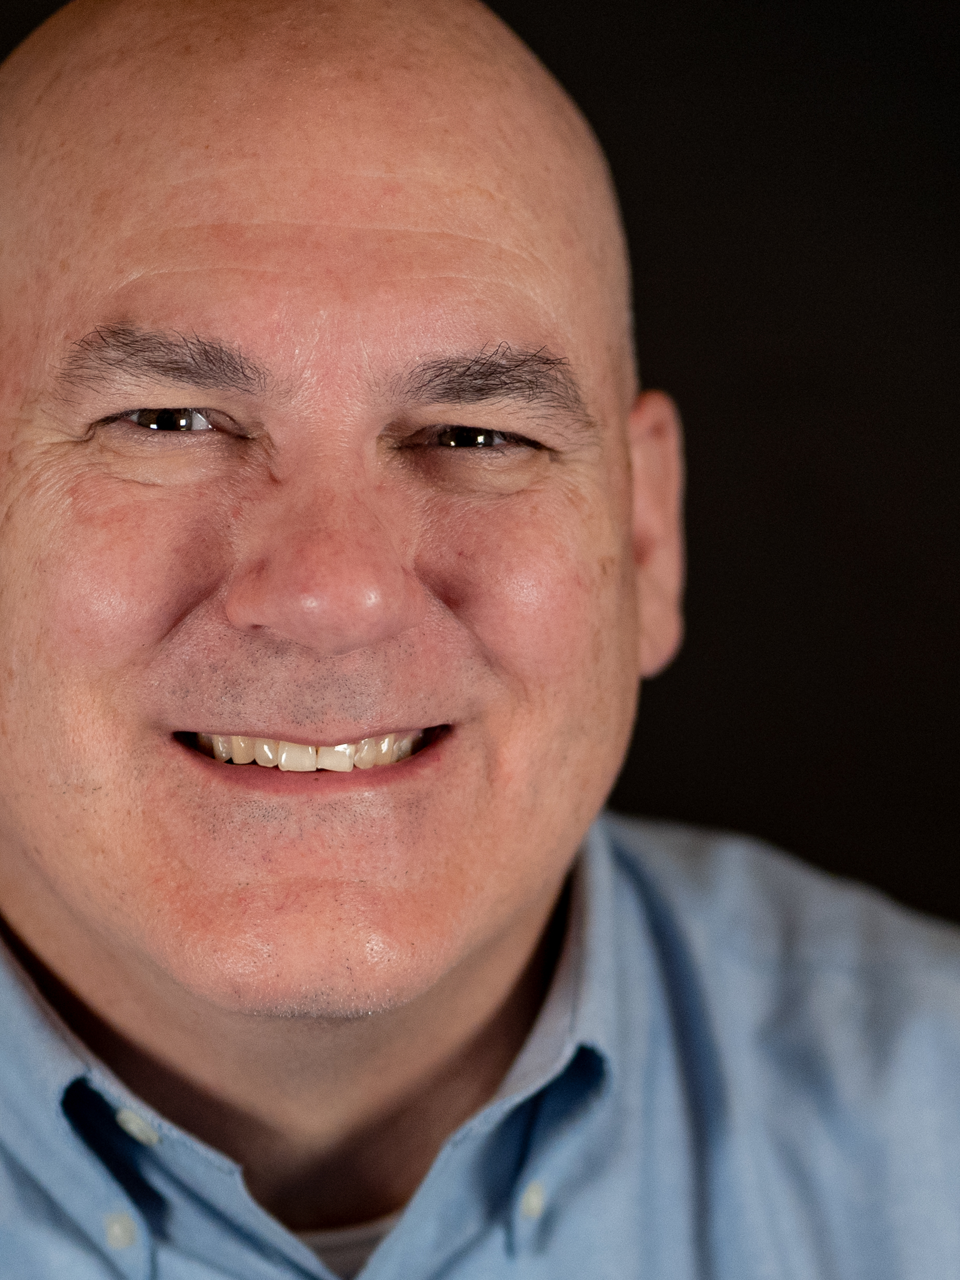
Michael Goshorn
- Director
Mike Goshorn has been involved in Theater ever since his daughter said they needed more “guys” after returning from an audition in 2013. Favorite roles: Henry Higgins: My Fair Lady, Maurice: Beauty and the Beast, Sir Wargrave: And Then There Were None. Mike is a founding member of Goose Creek Players. He gives thanks to God, and to his patient family, especially his loving wife.

Slide 3
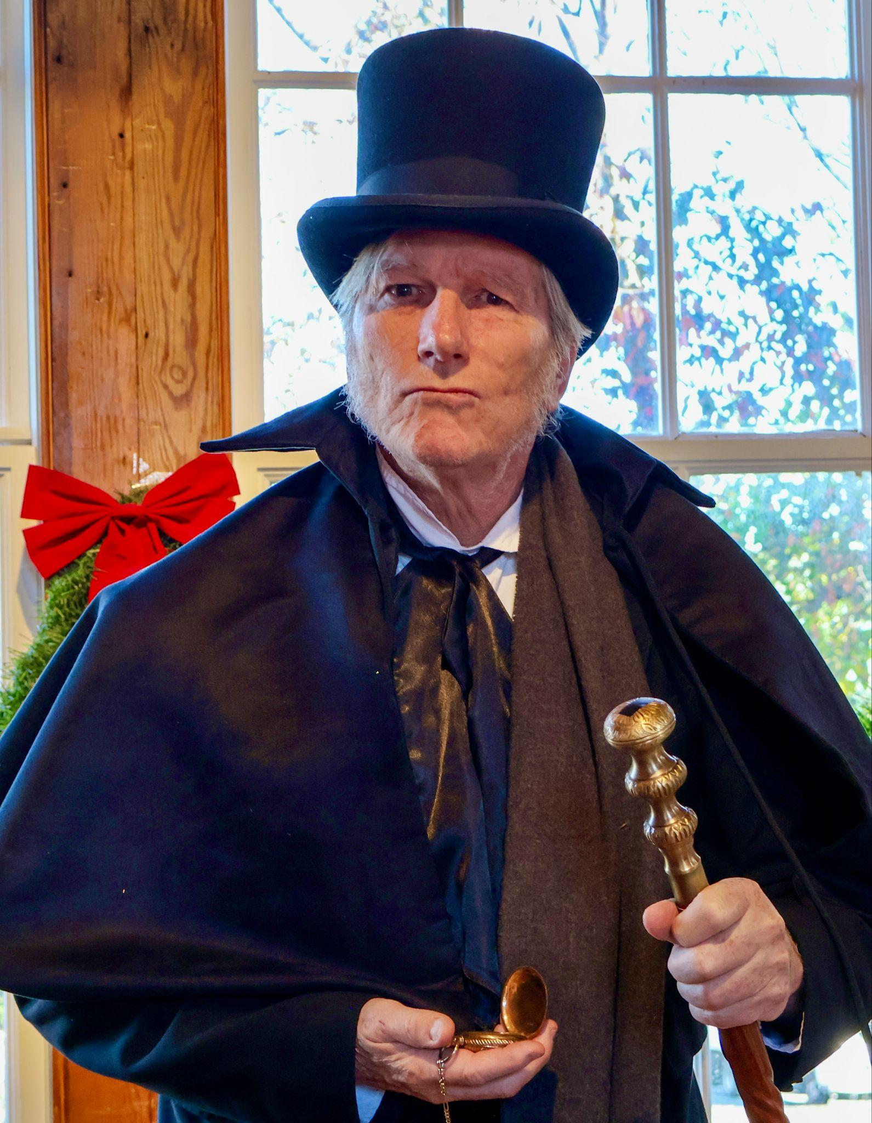
Phil Erickson
- Ebenezer Scrooge
Phil Erickson is delighted to work with a talented group of old and new friends roaming the streets of 19th Century London.
And * BONUS* he gets to watch his wife Penny act in multiple roles.
Ask him how he makes authentic Christmas pudding (as Charles Dickens would have it) and he'll tell you. Mmmmm.

Slide 4
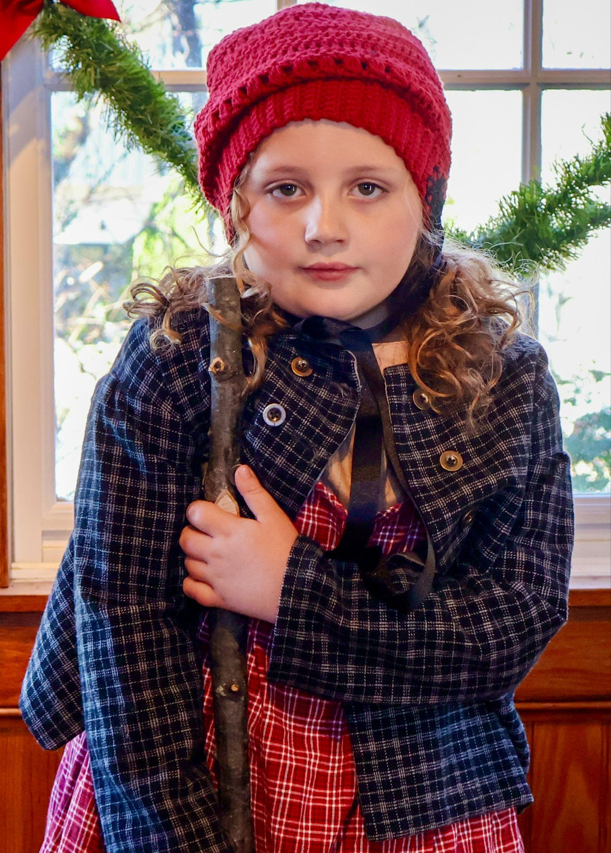
Audrey Kavanagh
- Tiny Tina & Ensemble
Audrey Kavanagh is continuing her love of the stage after performing in Anastasia (Pickwick Players) last spring. She is 8 years old, in third grade at Legacy Elementary, and enjoys swimming and cheerleading, as well as spending time with her two pugs, Olive and Noelle.
Audrey is elated to have her first major role and thanks Goose Creek Players for the opportunity.

Slide 5
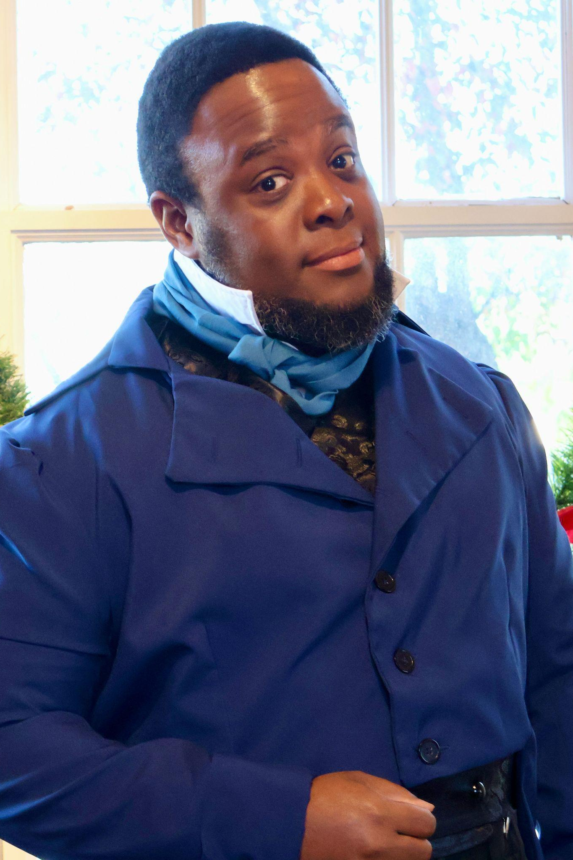
Trent McIntosh
- Ghost of Christmas Past & Ensemble
After being away from acting for over 10 years for an IT career, Trent is grateful for returning to the stage in A Christmas Carol.
He previously performed in opera, TV, film, and hosted a YouTube channel for mobile tech reviews.

Slide 6
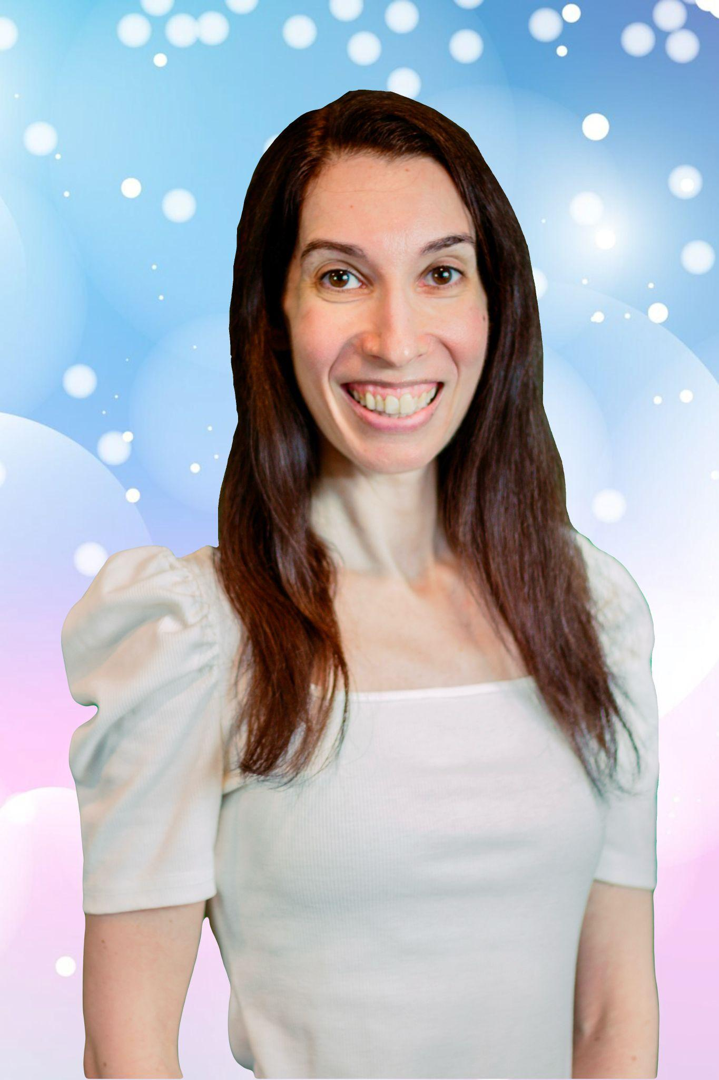
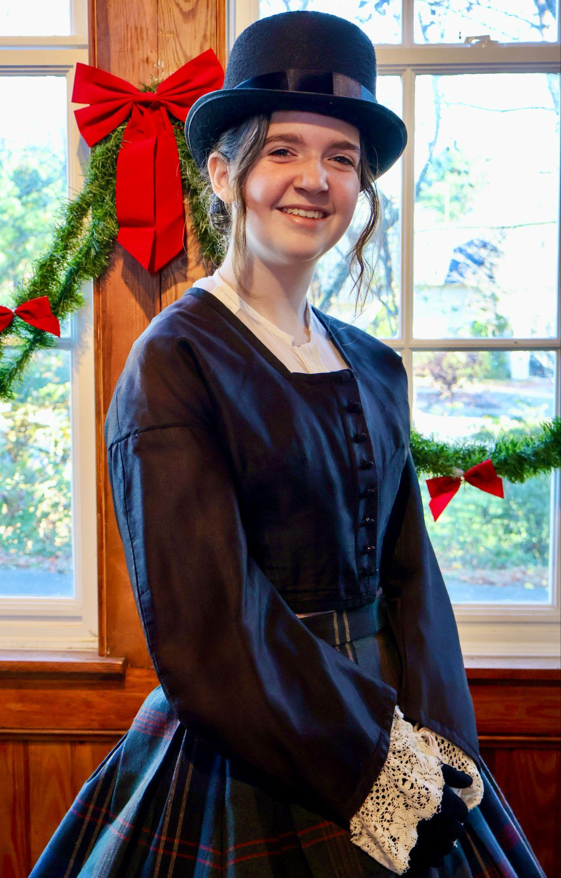
Mackenzie Gray
- Banker & Ensemble
Mackenzie Gray has performed in Miracle on 34th Street, A Christmas Story, and The Crucible. She also worked on stage crew for Sense & Sensibility, The Misfit Players, and Cinderella.
She enjoys swimming, playing games, and hanging out with her cat, Miley.

Slide 7
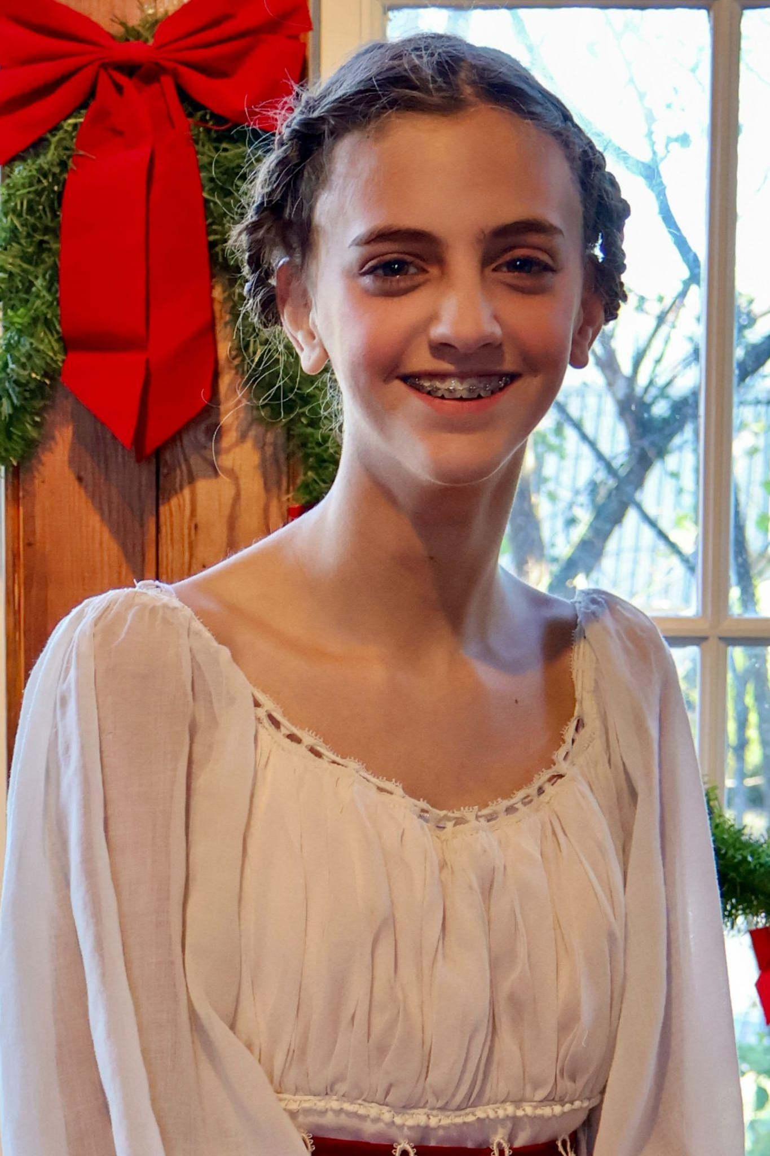
Hailey Barton
- Banker & Ensemble
Hailey Barton is a 7th grade student at Harmony Middle School. This performance marks her 6th show in 2024.
She would like to thank her parents for letting her participate in theater and all of her friends for being really supportive.

Slide 8
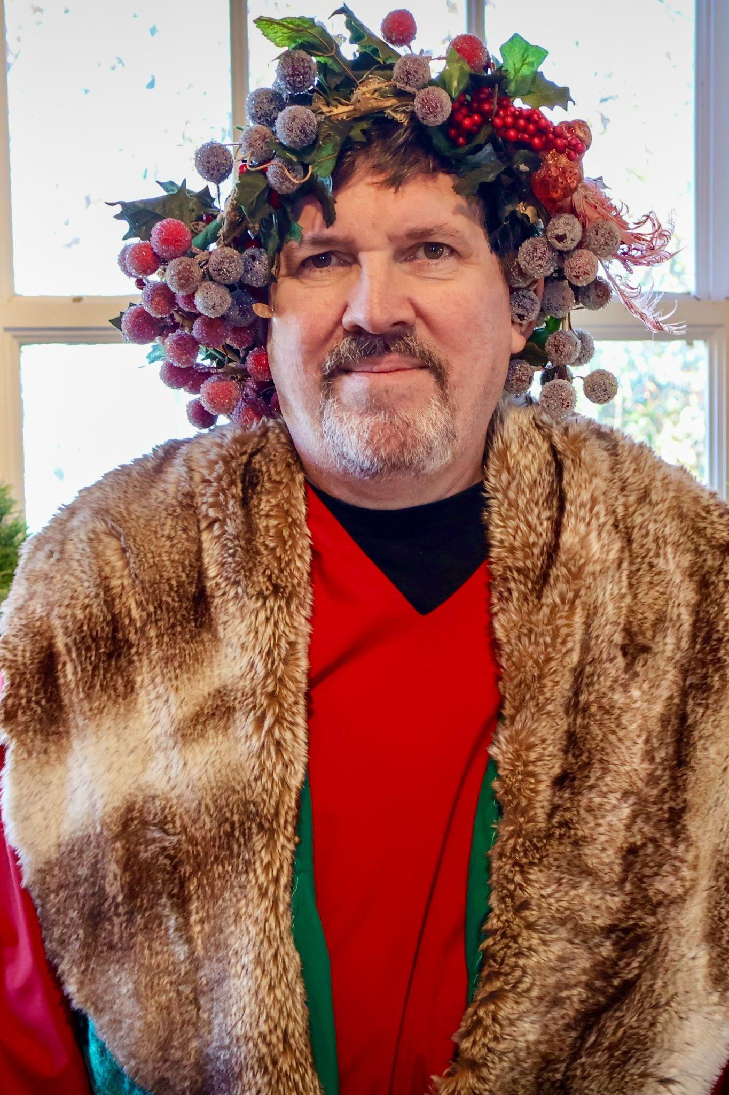
Dennis McCafferty
- Ghost of Christmas Present
Dennis McCafferty, a semi-retired former journalist, began performing with Goose Creek Players in 2019 when he played Uncle Billy in It's a Wonderful Life.
Other GCP productions include Cinderella, And Then There Were None, and The Crucible. Dennis has also appeared in One Flew Over the Cuckoo’s Nest (Sterling Playmakers) and Our Town (Reston Community Players).

Slide 9
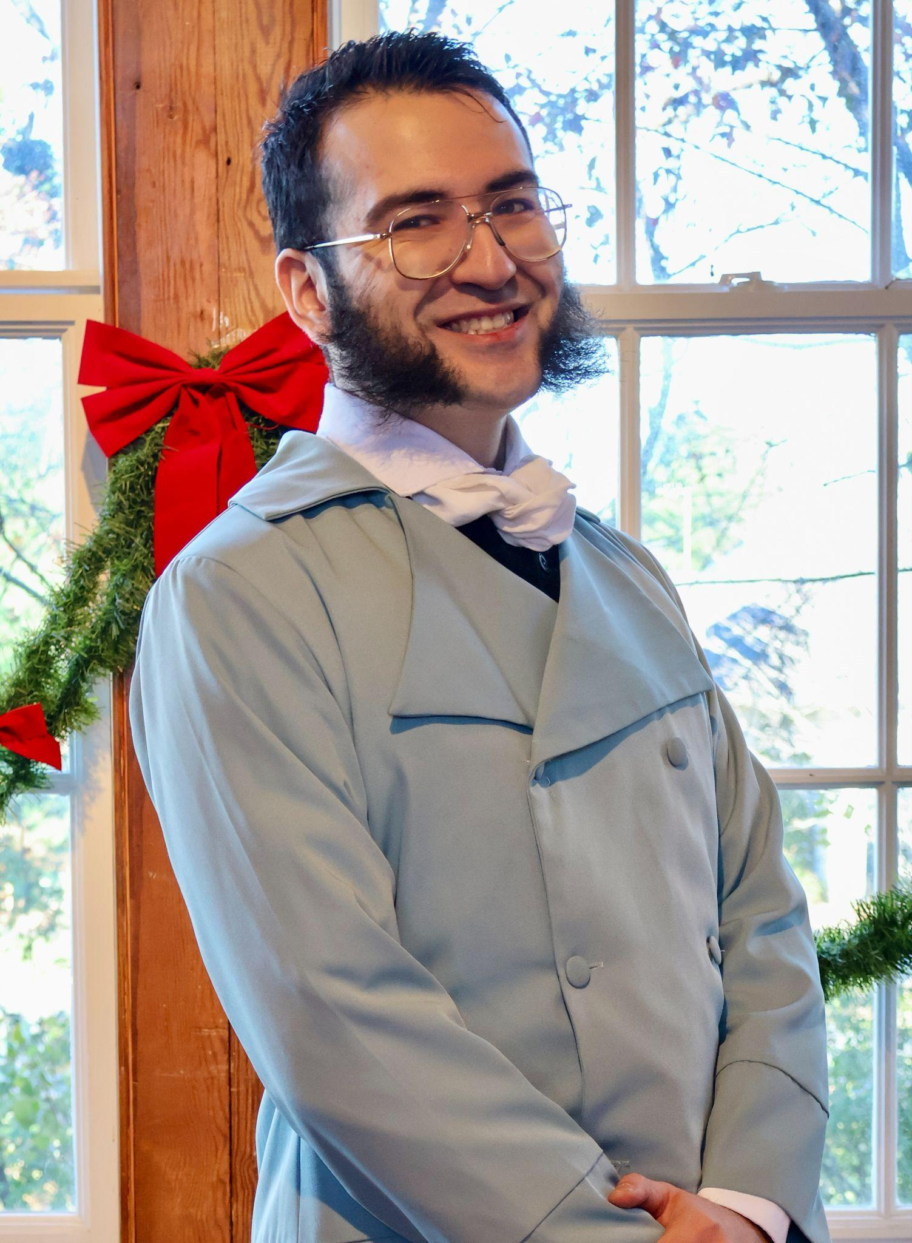
Belol Nessar
- Fred
Belol Nessar is coming out of his shell this year and excited to be onstage with Goose Creek Players.
His role as Fred has taught him that Christmas is all about KFC (Kindness, Friendship, and Charity). He enjoys The Simpsons, crochet, and tabletop RPGs.

Slide 10
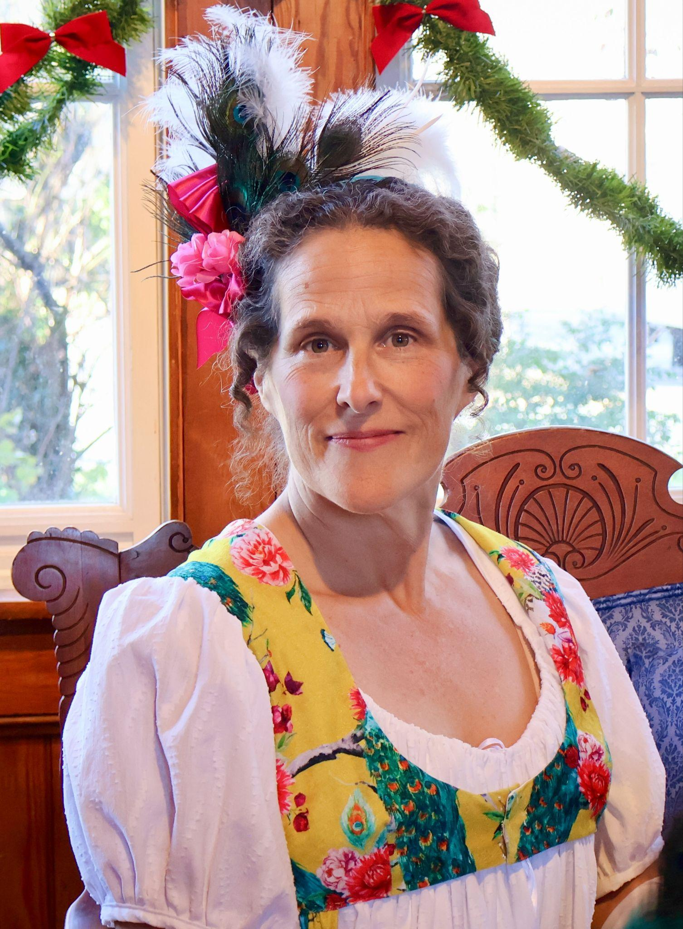
Penny Hauffe
- Narrator One, Mrs. Fezziwig, Ms. Dilber
Penny Hauffe is delighted to re-visit A Christmas Carol with so many wonderful friends, old and new. Being on stage with her husband, Phil Erickson, for almost 20 years is one of her greatest joys. Penny also enjoys her full-time job as a freelance artist.
Thank you for starting the Christmas Season here with us!

Slide 11
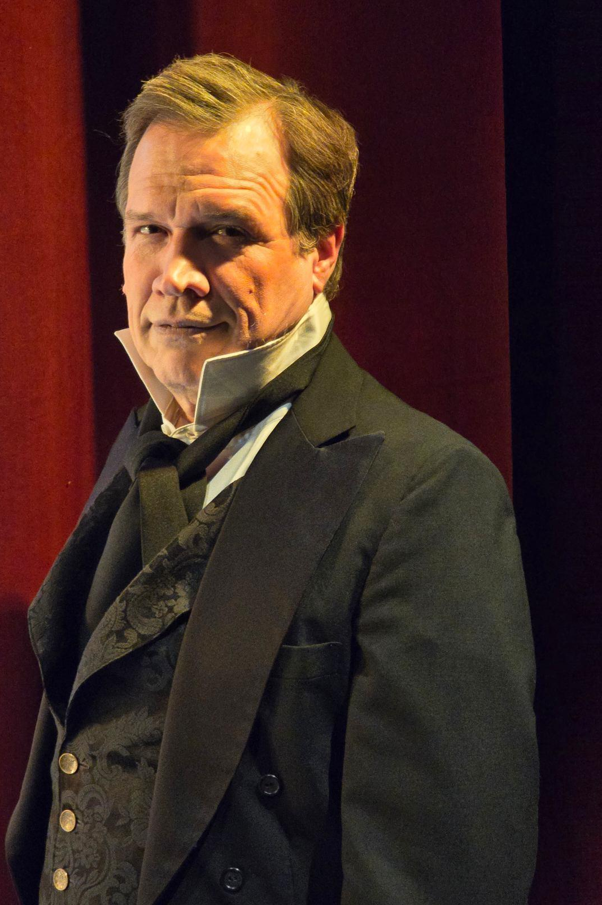
Jon Mark Rogers
- Jacob Marley
Mr. Rogers is happy to join the cast and crew of A Christmas Carol. He currently serves as Theatre Arts Supervisor for Loudoun County Public Schools. Acting credits include Film & TV, but stage roles remain his passion.
Previous stage roles include Hamlet (Hamlet), Dr. Treves (The Elephant Man), Ringmaster (Barnum), and Don Pedro (Much Ado About Nothing).
He was recently honored as Theatre Arts Administrator of the Year by Virginia Thespians.

Slide 12
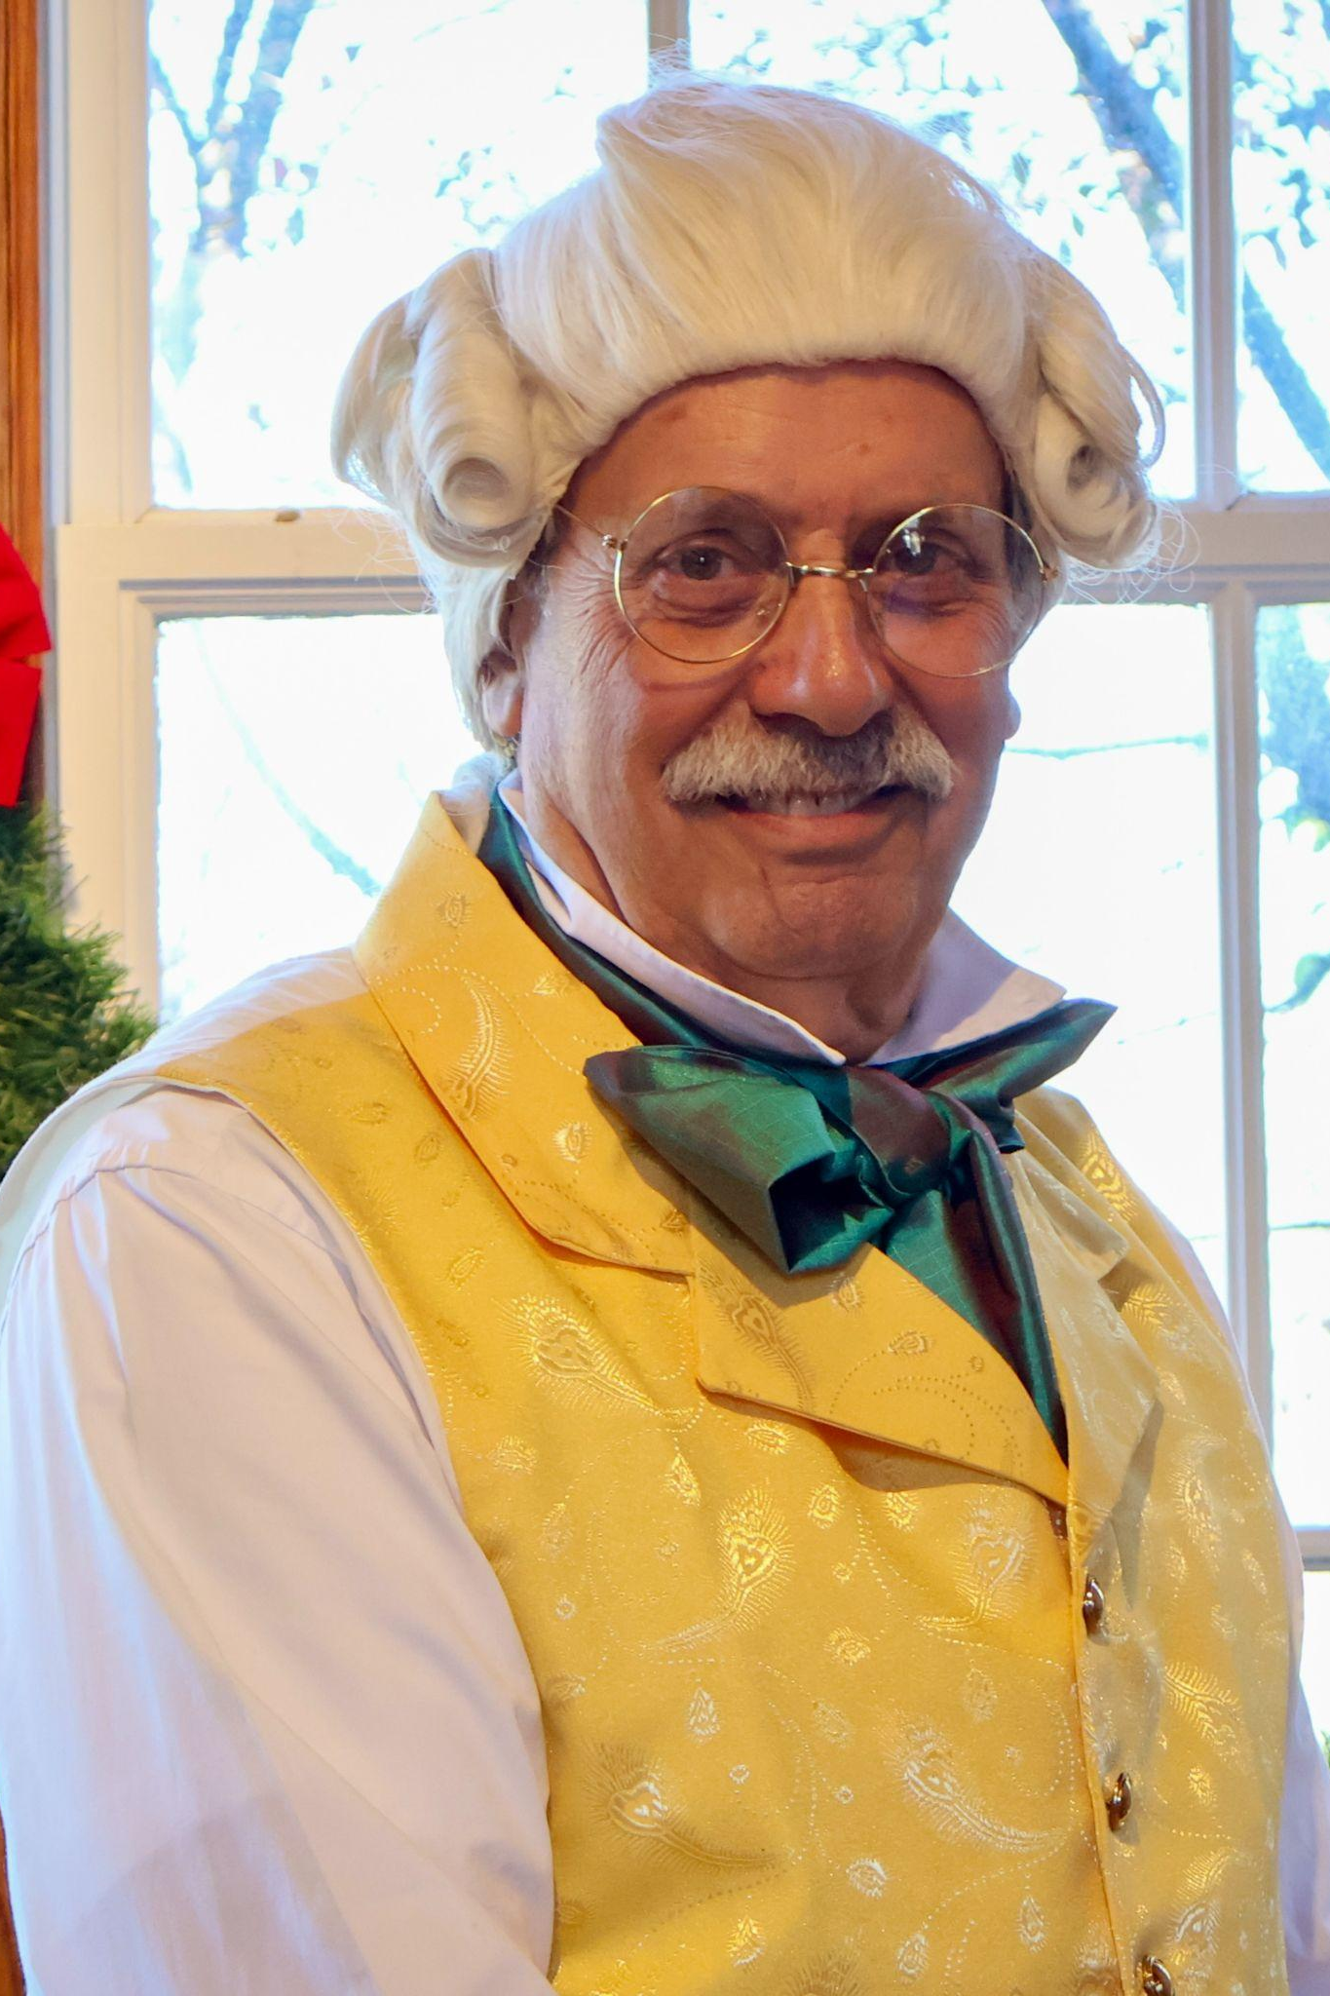
Ernie Carnevale
- Mr. Fezziwig & Mr. Tackleton
Ernie is very excited to portray Fezziwig, who is alive again. A thank you to a great cast, crew, production team and director.
When Ernie is not dancing, he enjoys cooking, golfing, raising chickens, and running lines with his very supportive wife, Patti.
Happy Holidays to all!

Slide 13
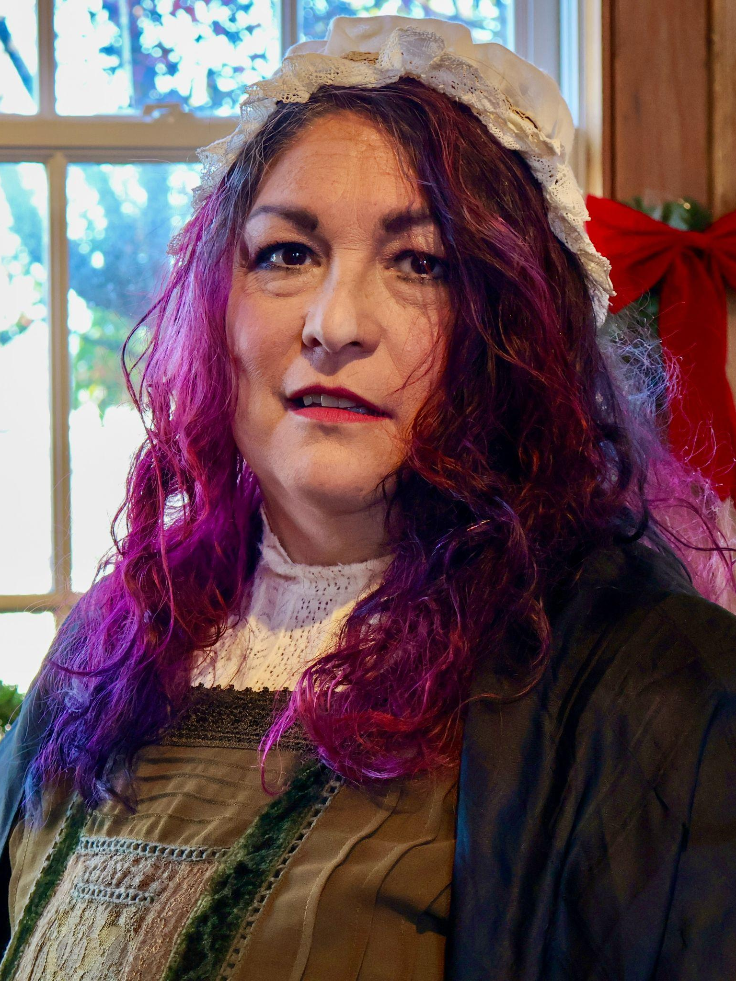
Julie Taylor
- Oppressions of Greed, Bitterness
Student Director of one of the Acts
In her sixth production with Goose Creek Players, Julie Taylor is embracing a new challenge as a silent Spirit and taking on her first directing role for Act 4.
She also keeps busy with her 6 sons, homeschooling, and her latest endeavor- writing murder mystery stories as a member of Glass Girls Productions.

Slide 14
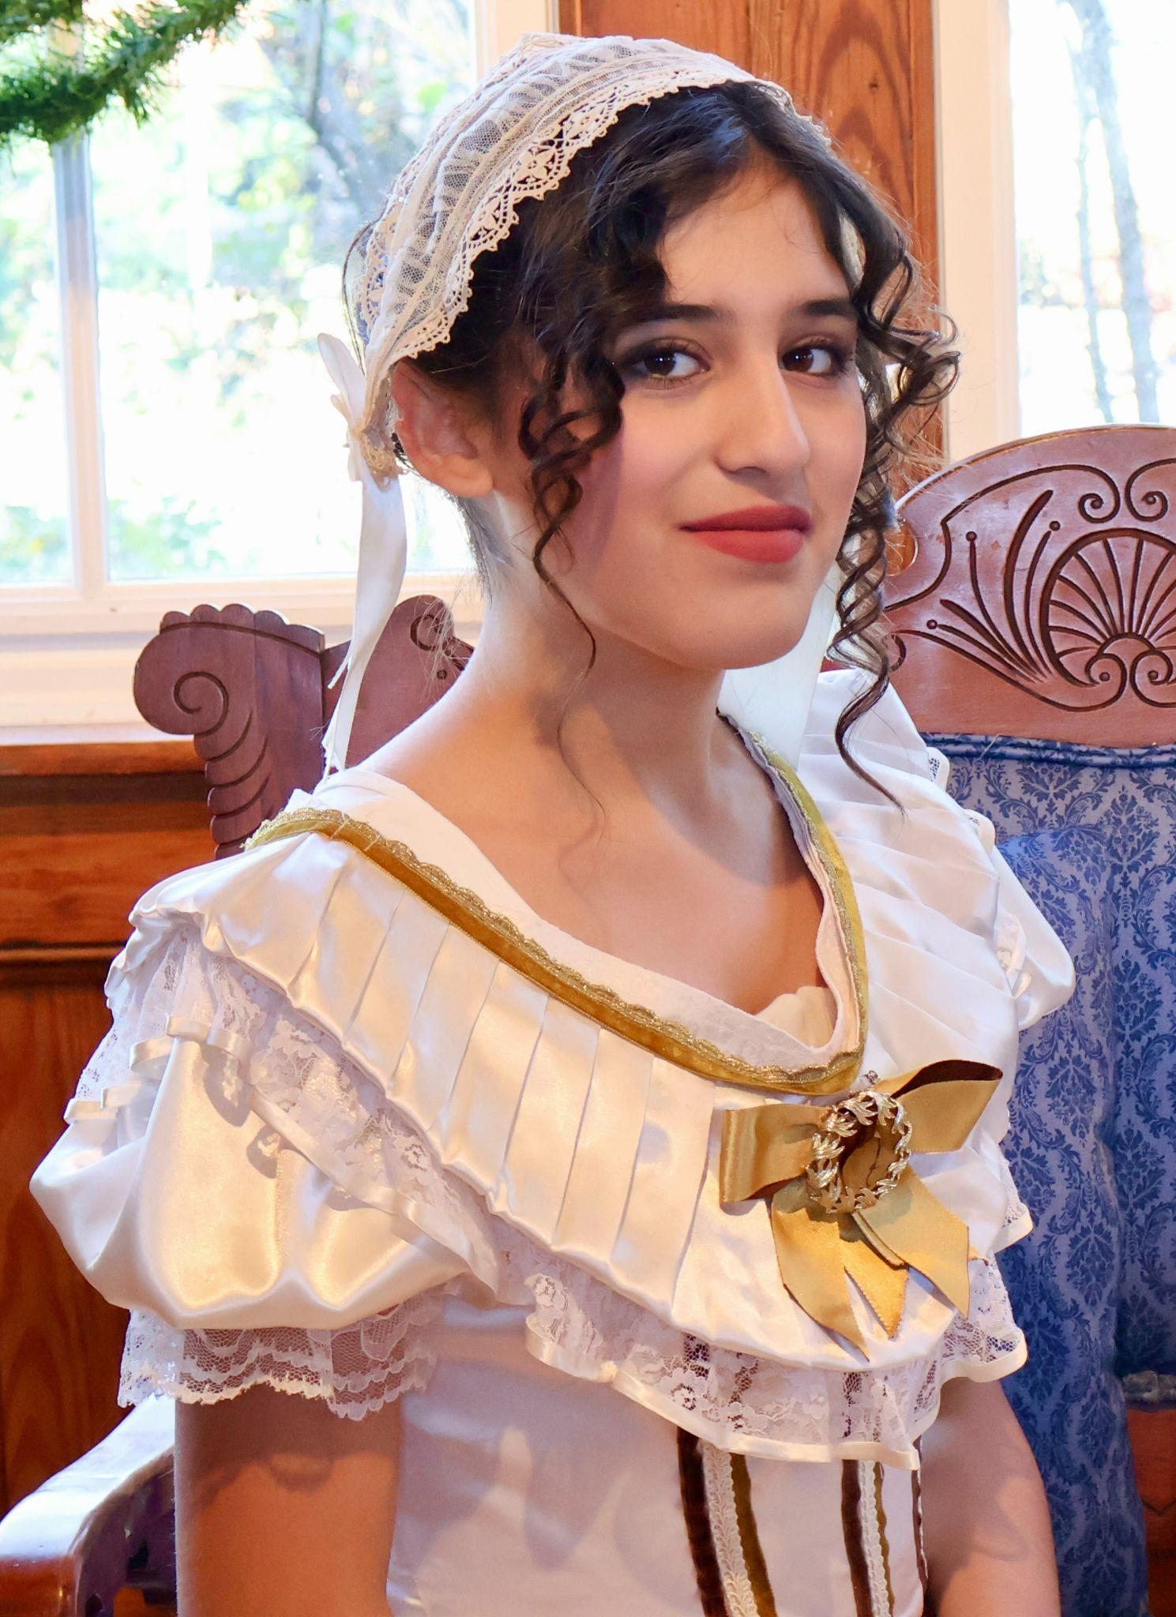
Liliana Brandt
- Fan & Petra
Liliana Brandt is making her stage debut. She is ecstatic to be a part of this ensemble and looks forward to participating in many more plays in the future.
She spends her days reading, reading, and reading more books. She is also a crafter and baker.

Slide 15
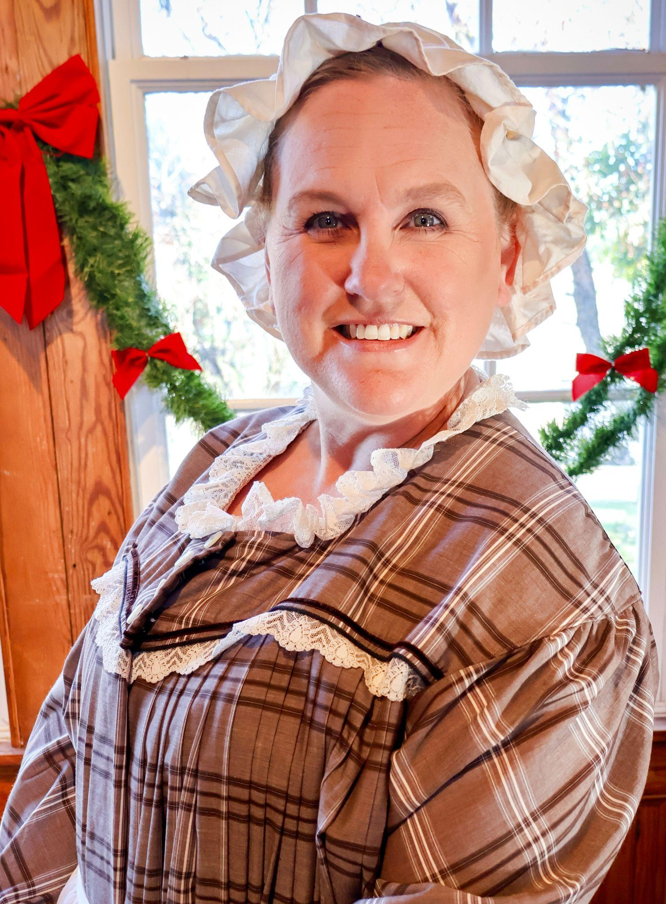
Melissa Barton
- Poulterer & Spirit
Melissa Barton is excited to return for her second stage performance and co-producing role with Goose Creek Players.
She’s especially thrilled to share the stage again with her daughter, Hailey, creating core memories they will treasure forever.

Slide 16
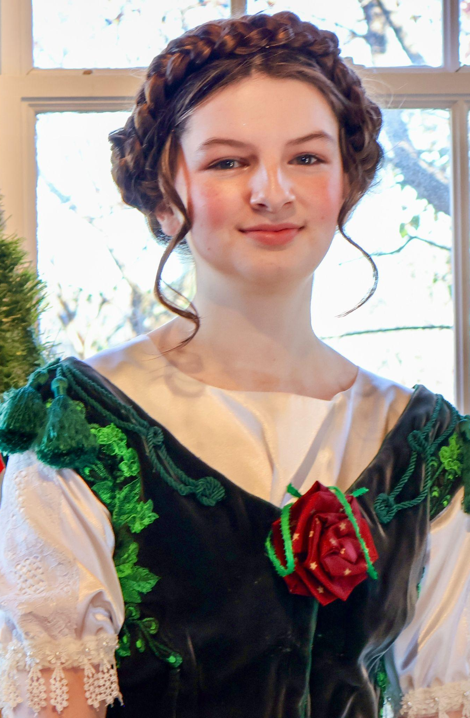
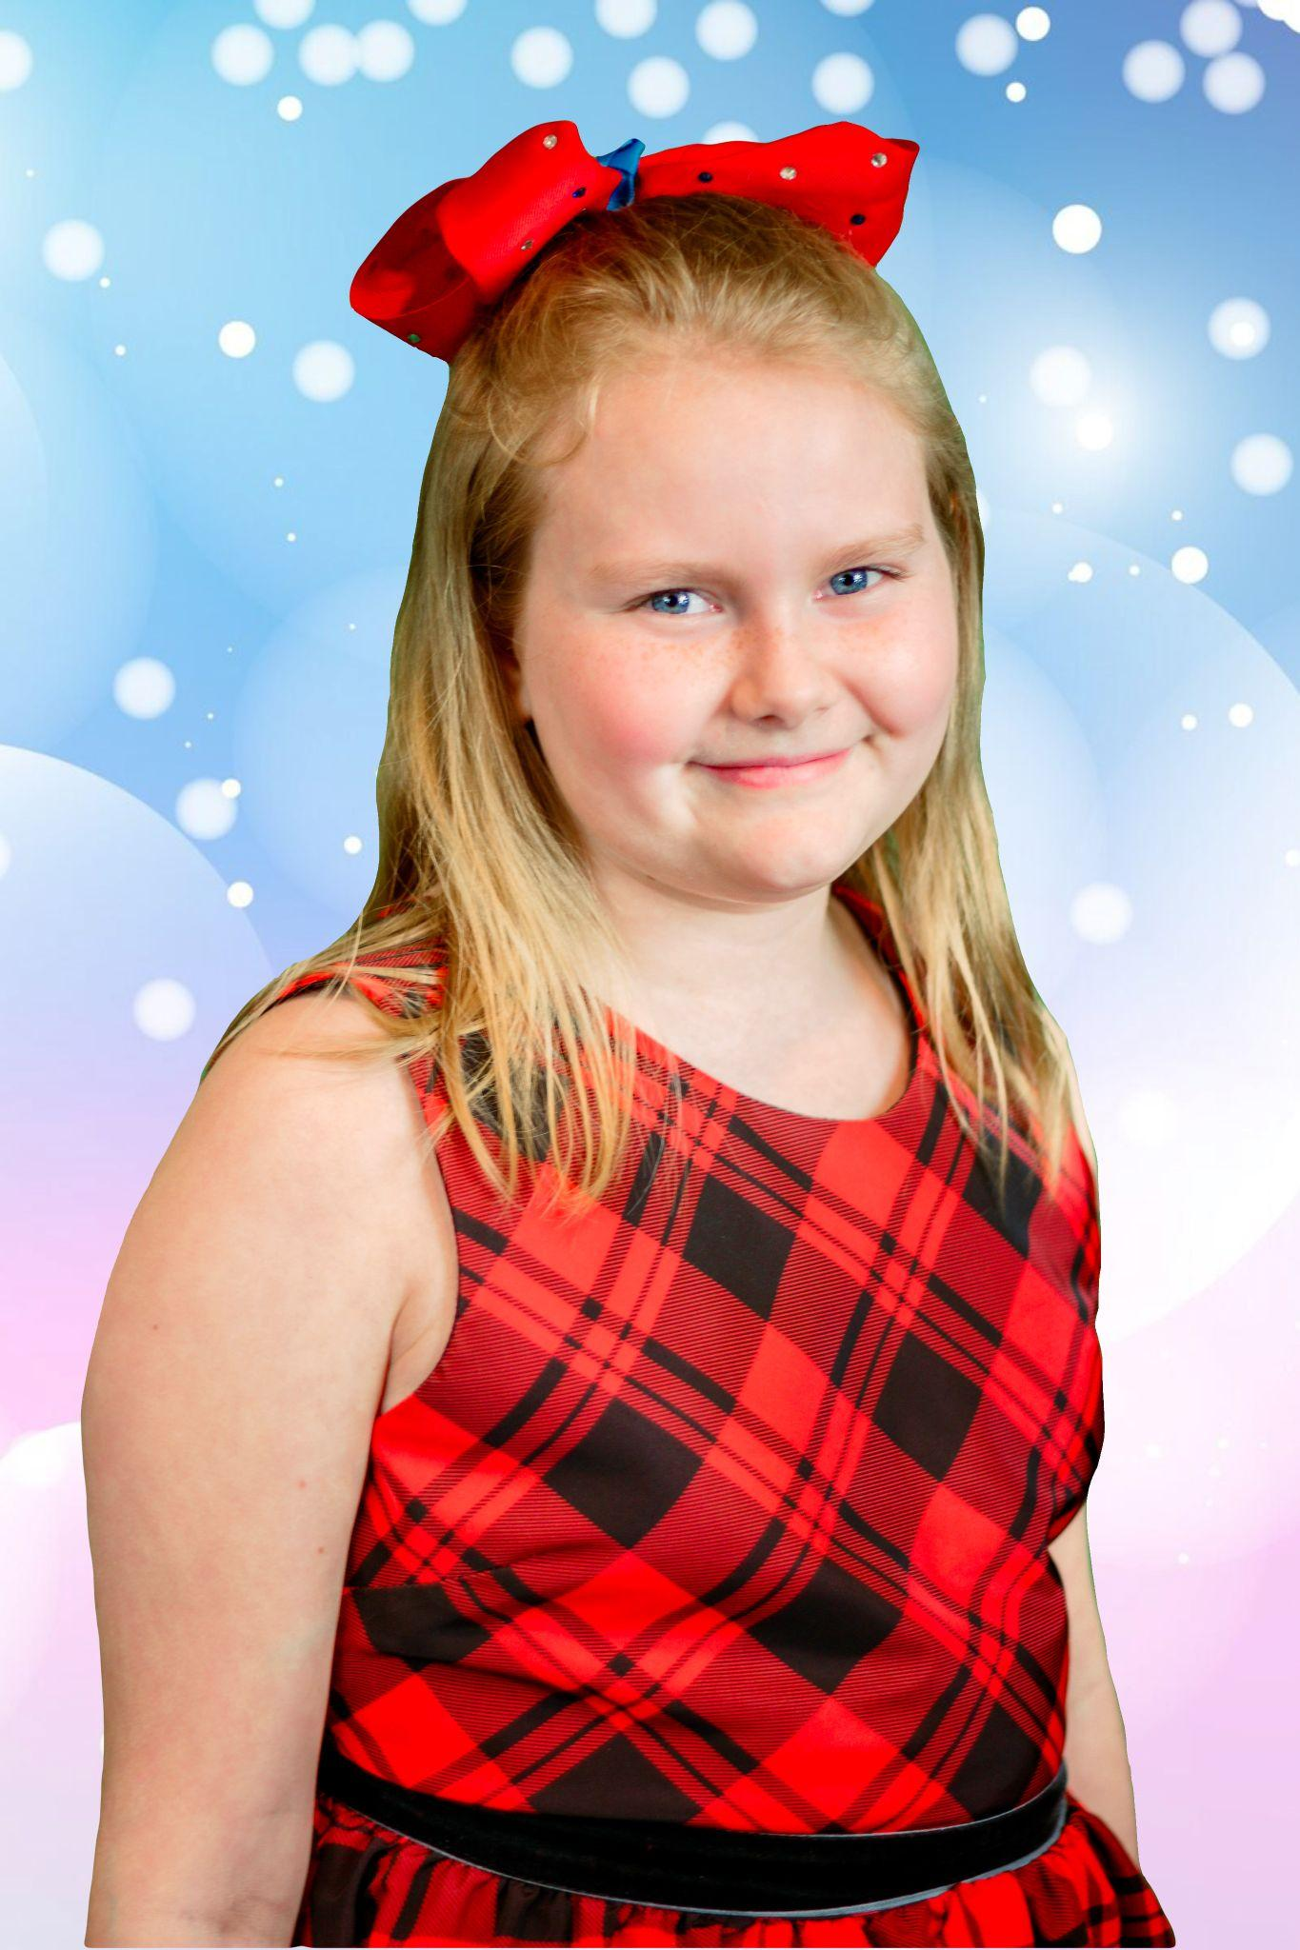
Lauren Pyles
- Belle
Lauren Pyles, a member of the Latvian royal family (second princess spare to the throne), is happy to perform with Goose Creek Players.
Her highness wishes to thank you for coming to the show, and hopes you have a Priecīgus Ziemassvētkus!!

Slide 17
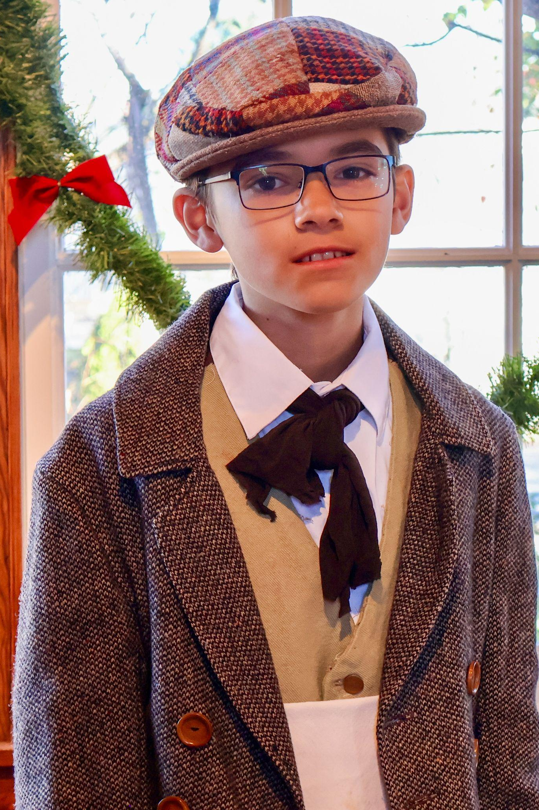
Eli Bain
- Turkey Boy
Big turkey coming through—and we’re not talking about the Christmas dinner!
Eli Valdez-Bain is debuting in his first-ever play. Excited and nervous, he’s ready to give it his all.
When not on stage, he enjoys playing Fortnite, soccer, and building computers.

Slide 18
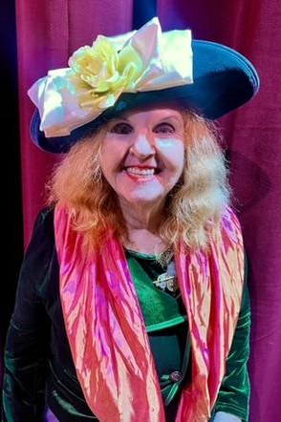
Kathleen Donovan
- Mrs. Oliver
Kathleen Donovan has enjoyed performing in community theatre throughout Delaware, Maryland, and Virginia for over 40 years.
Her most recent role was Mrs. Whitney in Dirty Works (Sterling Playmakers).
Kathleen also enjoys sword fighting with Sterling Sword Players.

Slide 19
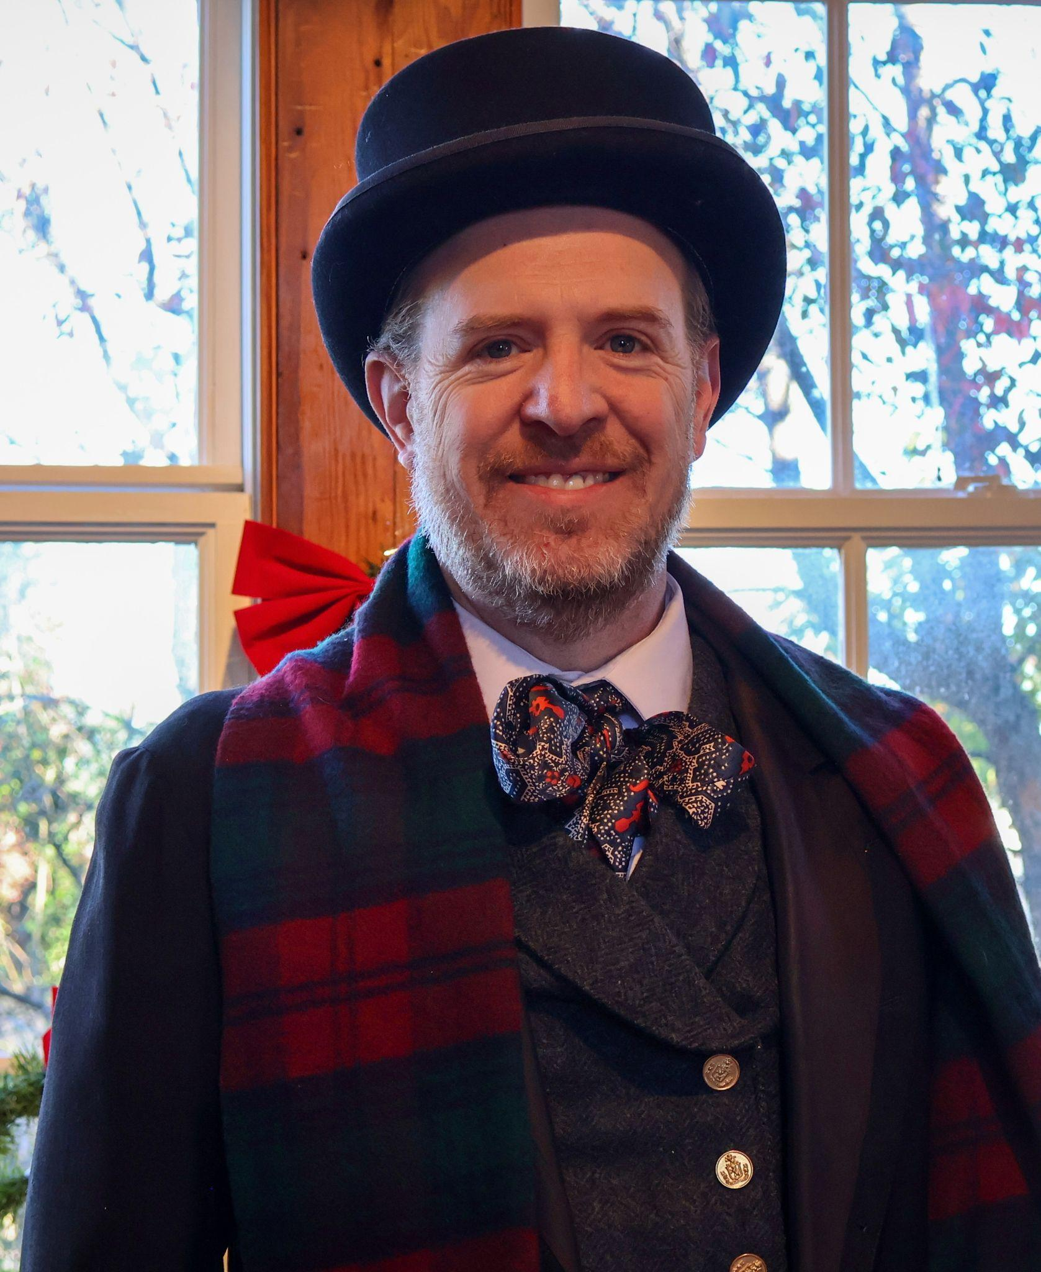
Eric Russell
- Bob Cratchit
As a lifelong fan of A Christmas Carol, Eric is enjoying being a part of his first show with Goose Creek Players.
He has previously performed as Mr. Pringle in Scrooge! the Musical and as Issachar in Joseph and the Amazing Technicolor Dreamcoat.

Slide 20
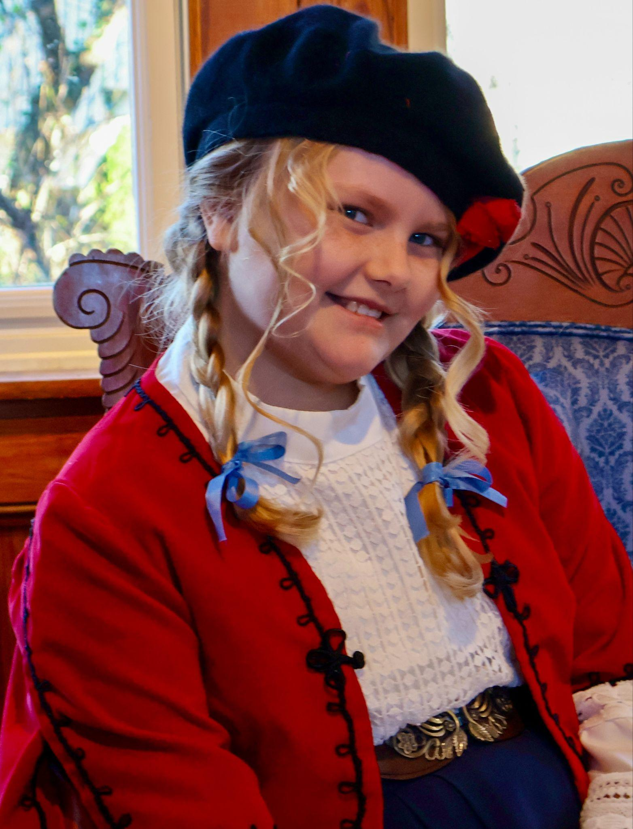
Violet Hafner
- Ensemble
This November, Violet celebrates her first full year in community theatre with her sixth show, A Christmas Carol.
She extends special thanks to her music and art teachers—Mrs. Stillman, Mr. Ford, Mrs. Rancourt, and Mrs. Mohler—and, of course, Dolly Parton, for igniting and fostering her passion.

Slide 21
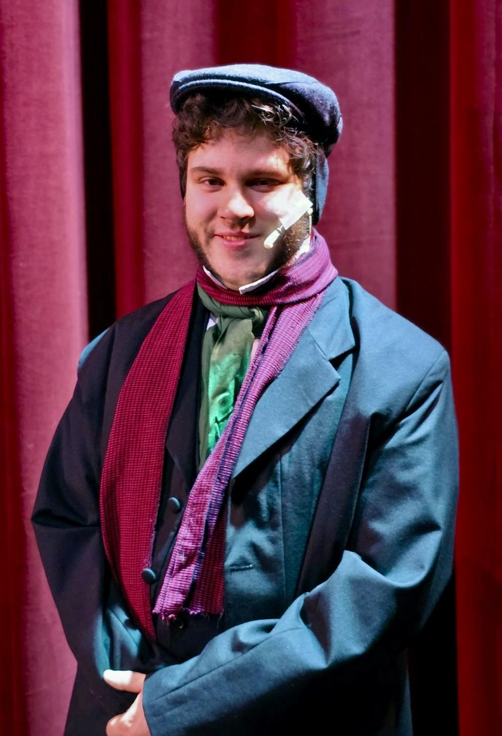
John Donovan
- Young Scrooge
John Dennis Donovan is delighted to return to stage for his second time with Goose Creek Players.
Favorite past roles include Dick Wilkins and Fred (A Christmas Carol), Joseph Pulitzer (Newsies), and Donalbain (The Scottish Play).
John thanks his grandmother, Kathleen Donovan, for inspiring him to pursue theater since he was knee-high.

Slide 22
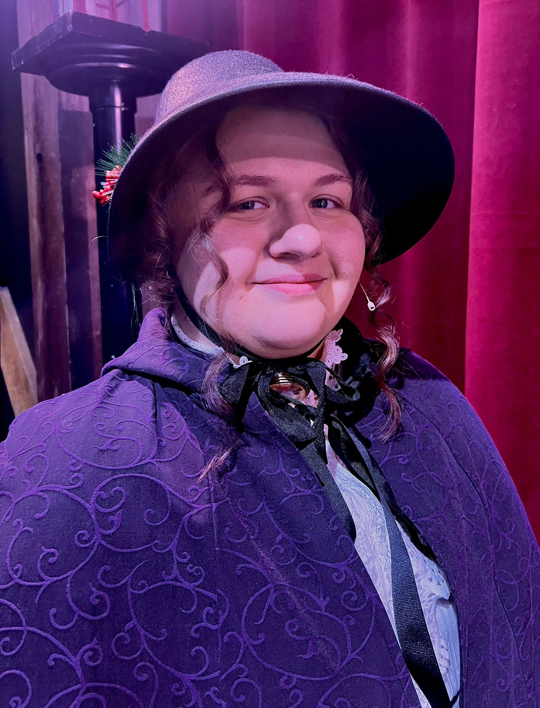
Jules Darmofalski
- Mrs. Bertram
Jules has been in a number of shows with Goose Creek Players, and has even started to Student Direct.
Jules hopes everyone enjoys the show!

Slide 23
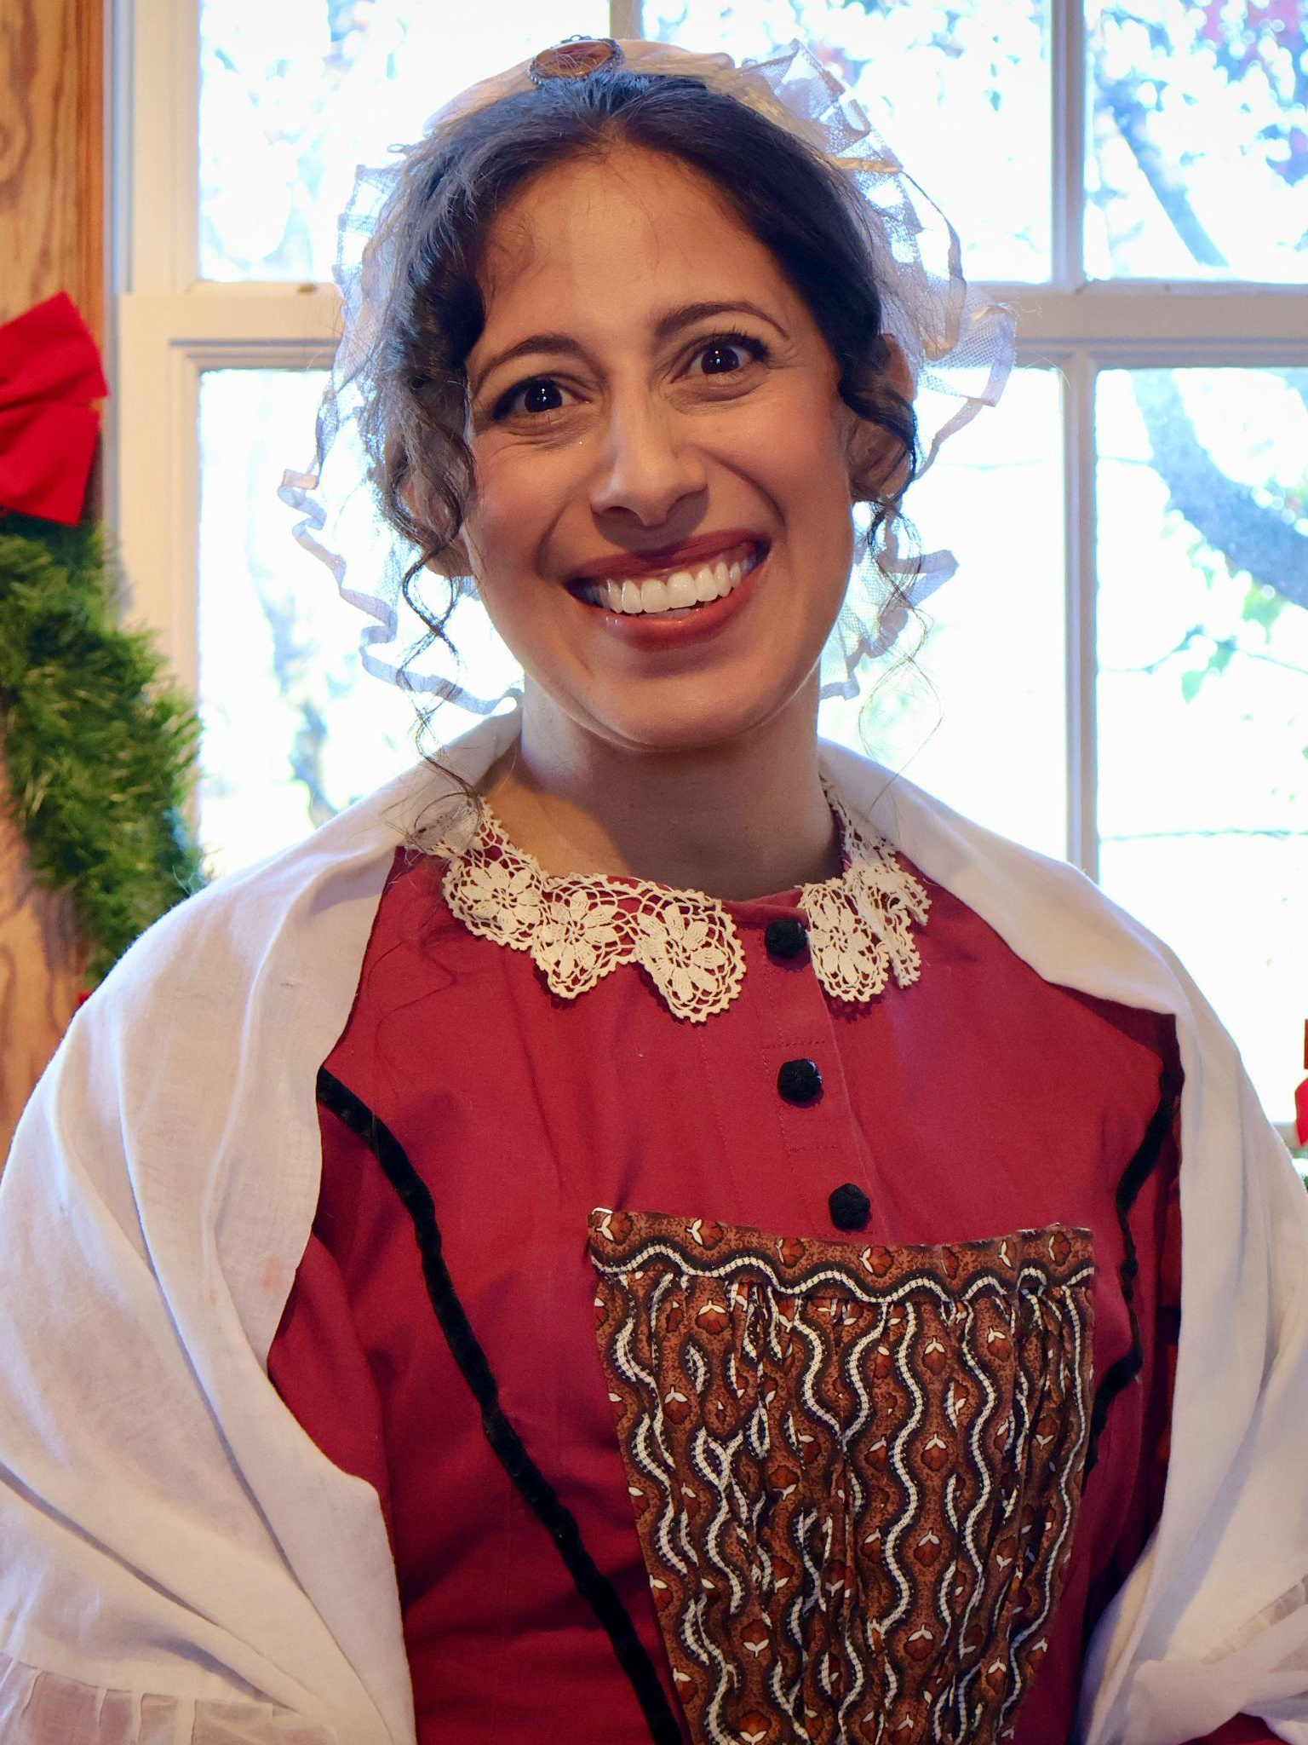
Veronica Brandt
- Martha Cratchit
Veronica Brandt is thrilled to be make her debut with this wonderfully talented cast. While this is her first performance on stage, she has performed countless times for her children through read-aloud books.
While not on stage, she is busy homeschooling four children. She loves challenges, reading, learning new things, and quiet time.

Slide 24
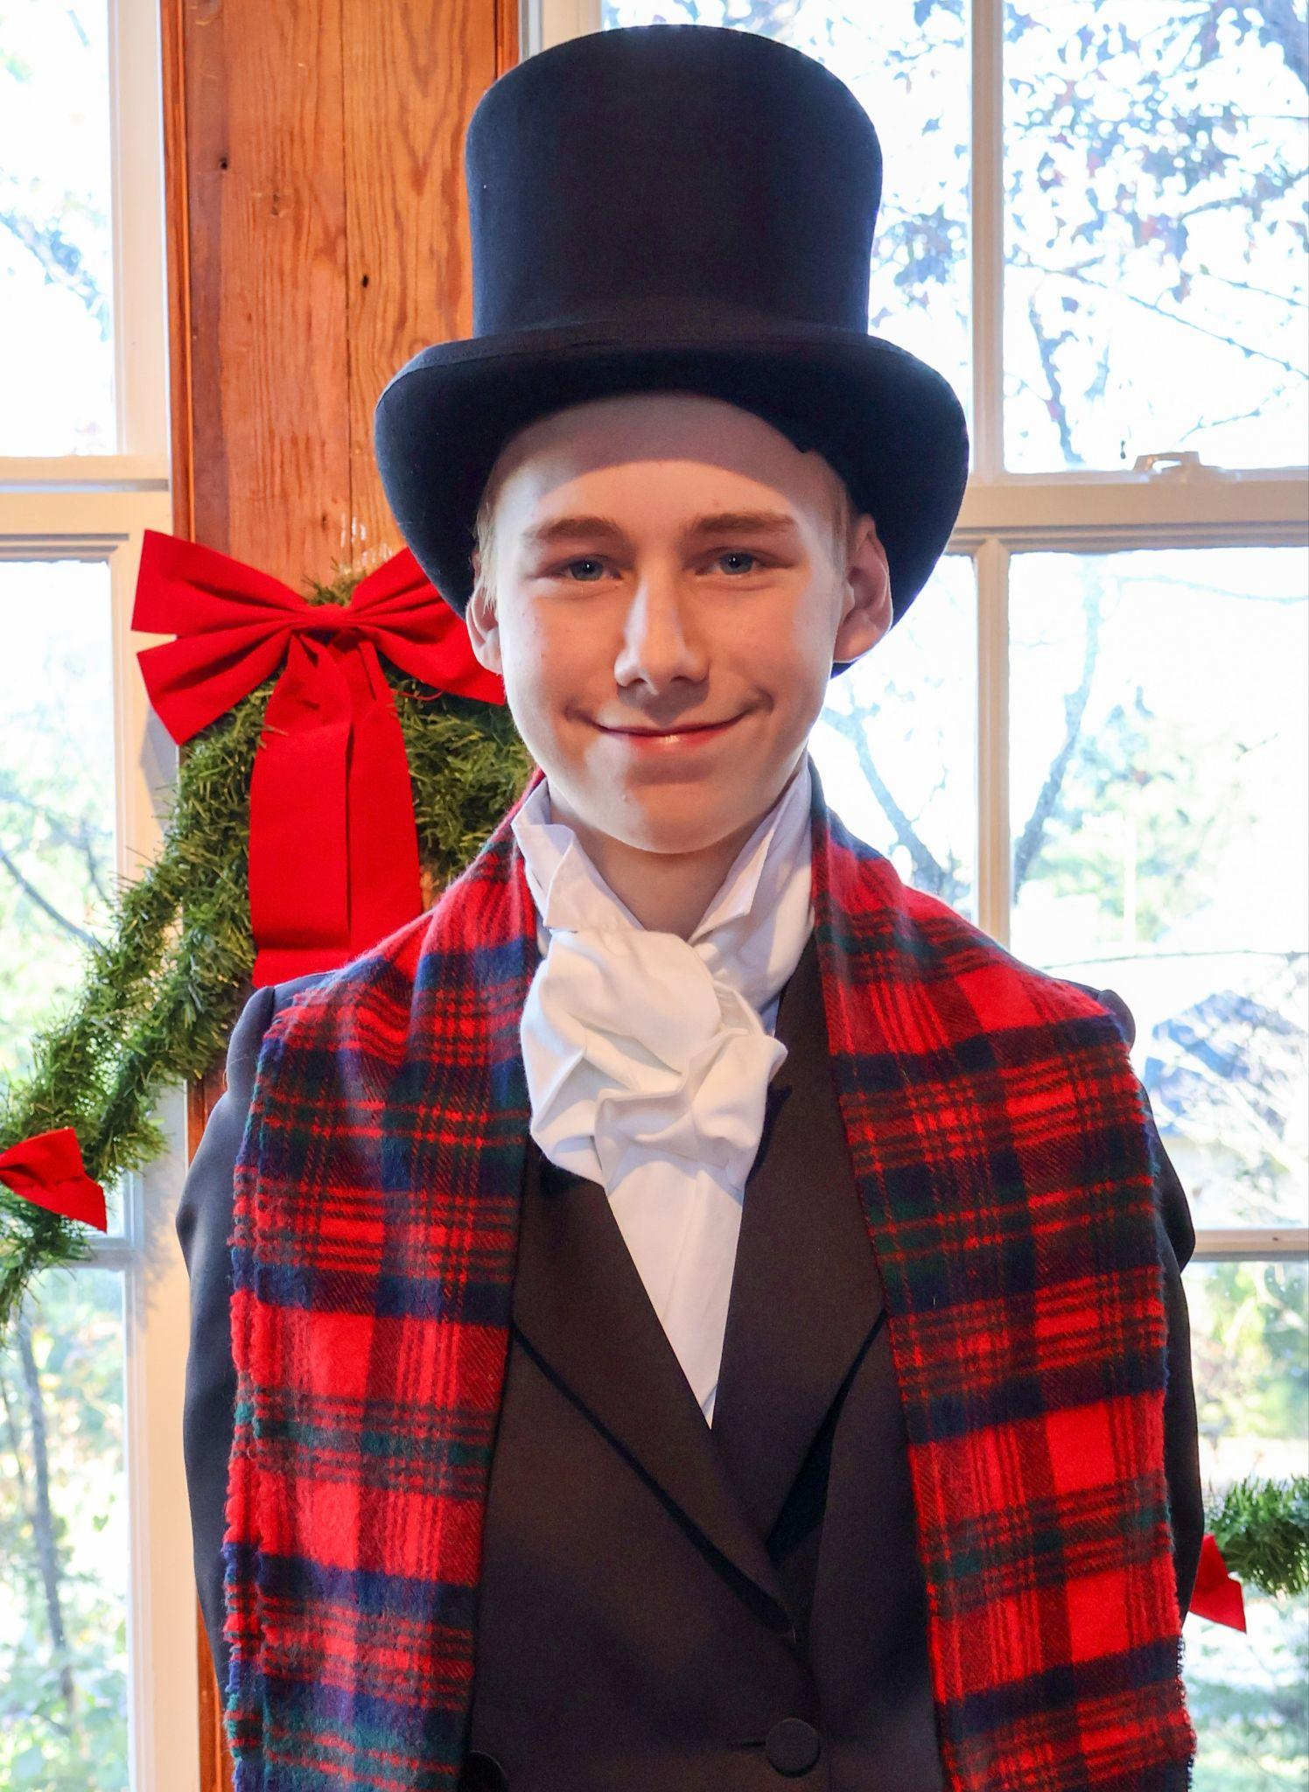
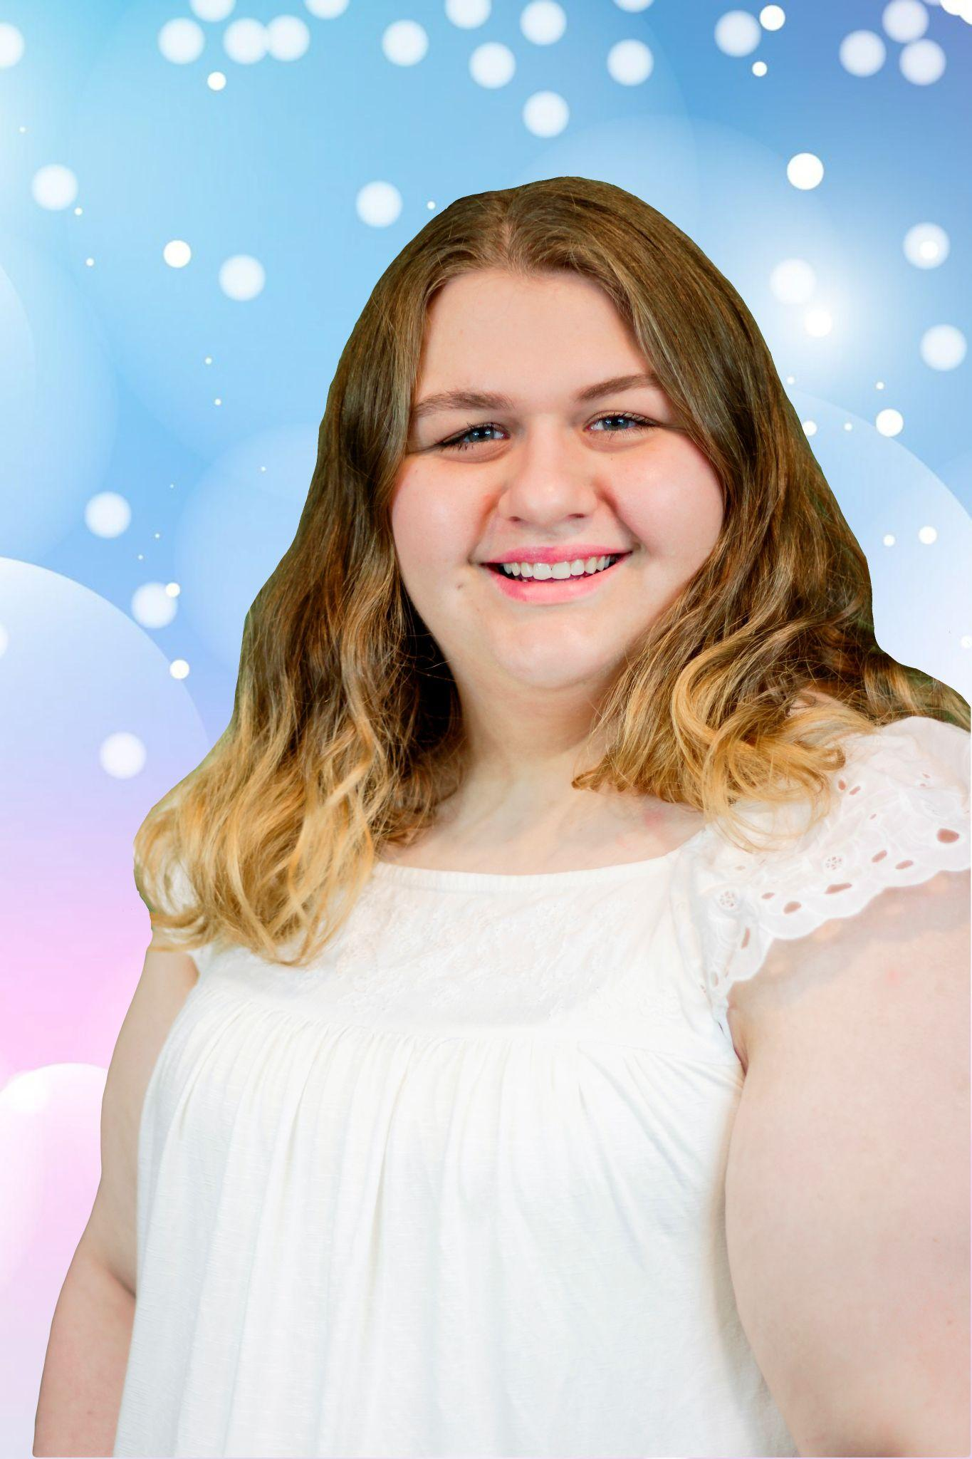
Adler Kohlweiler
- Dick Wilkins, Banker, & Belle’s Husband
Adler Kohlweiler is thrilled for this opportunity to perform his sixth show in this beloved classic.
In addition to acting, Adler thoroughly enjoys playing the cello as well as every strategy card game or board game he can find the time to play.

Slide 25
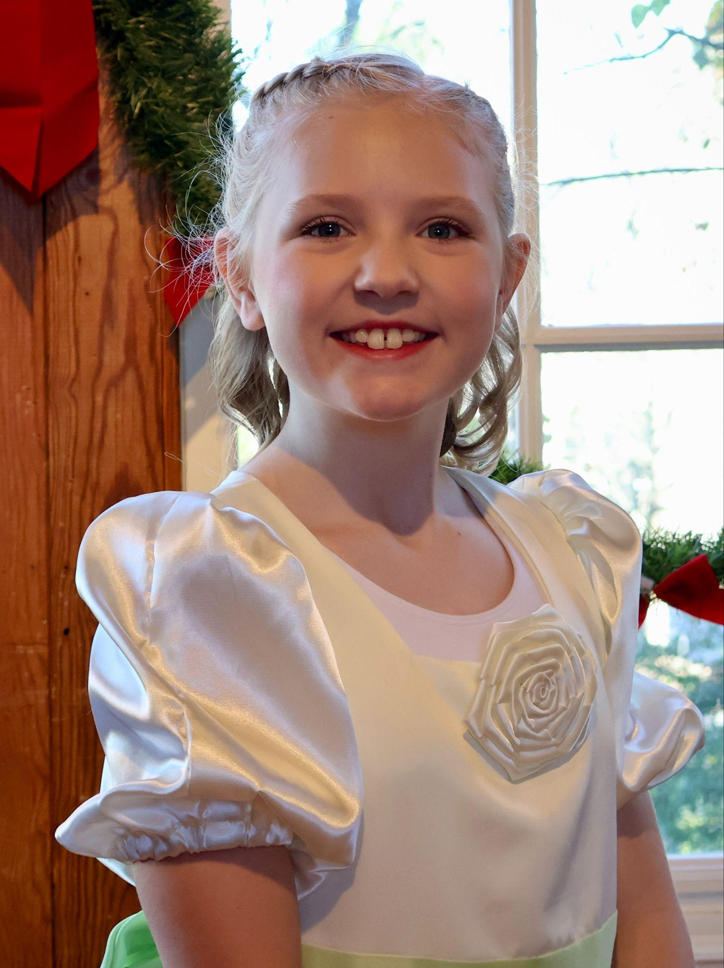
Grace Russell
- Cratchit Kid & Ensemble
This is Grace Russell’s first show with Goose Creek Players.
Previously, she has performed as Charlie Bucket in Willy Wonka Jr, Hei Hei in Moana Jr, Smee in Peter Pan Jr, and as a munchkin in Shenandoah University’s production of The Wizard of Oz.

Slide 26
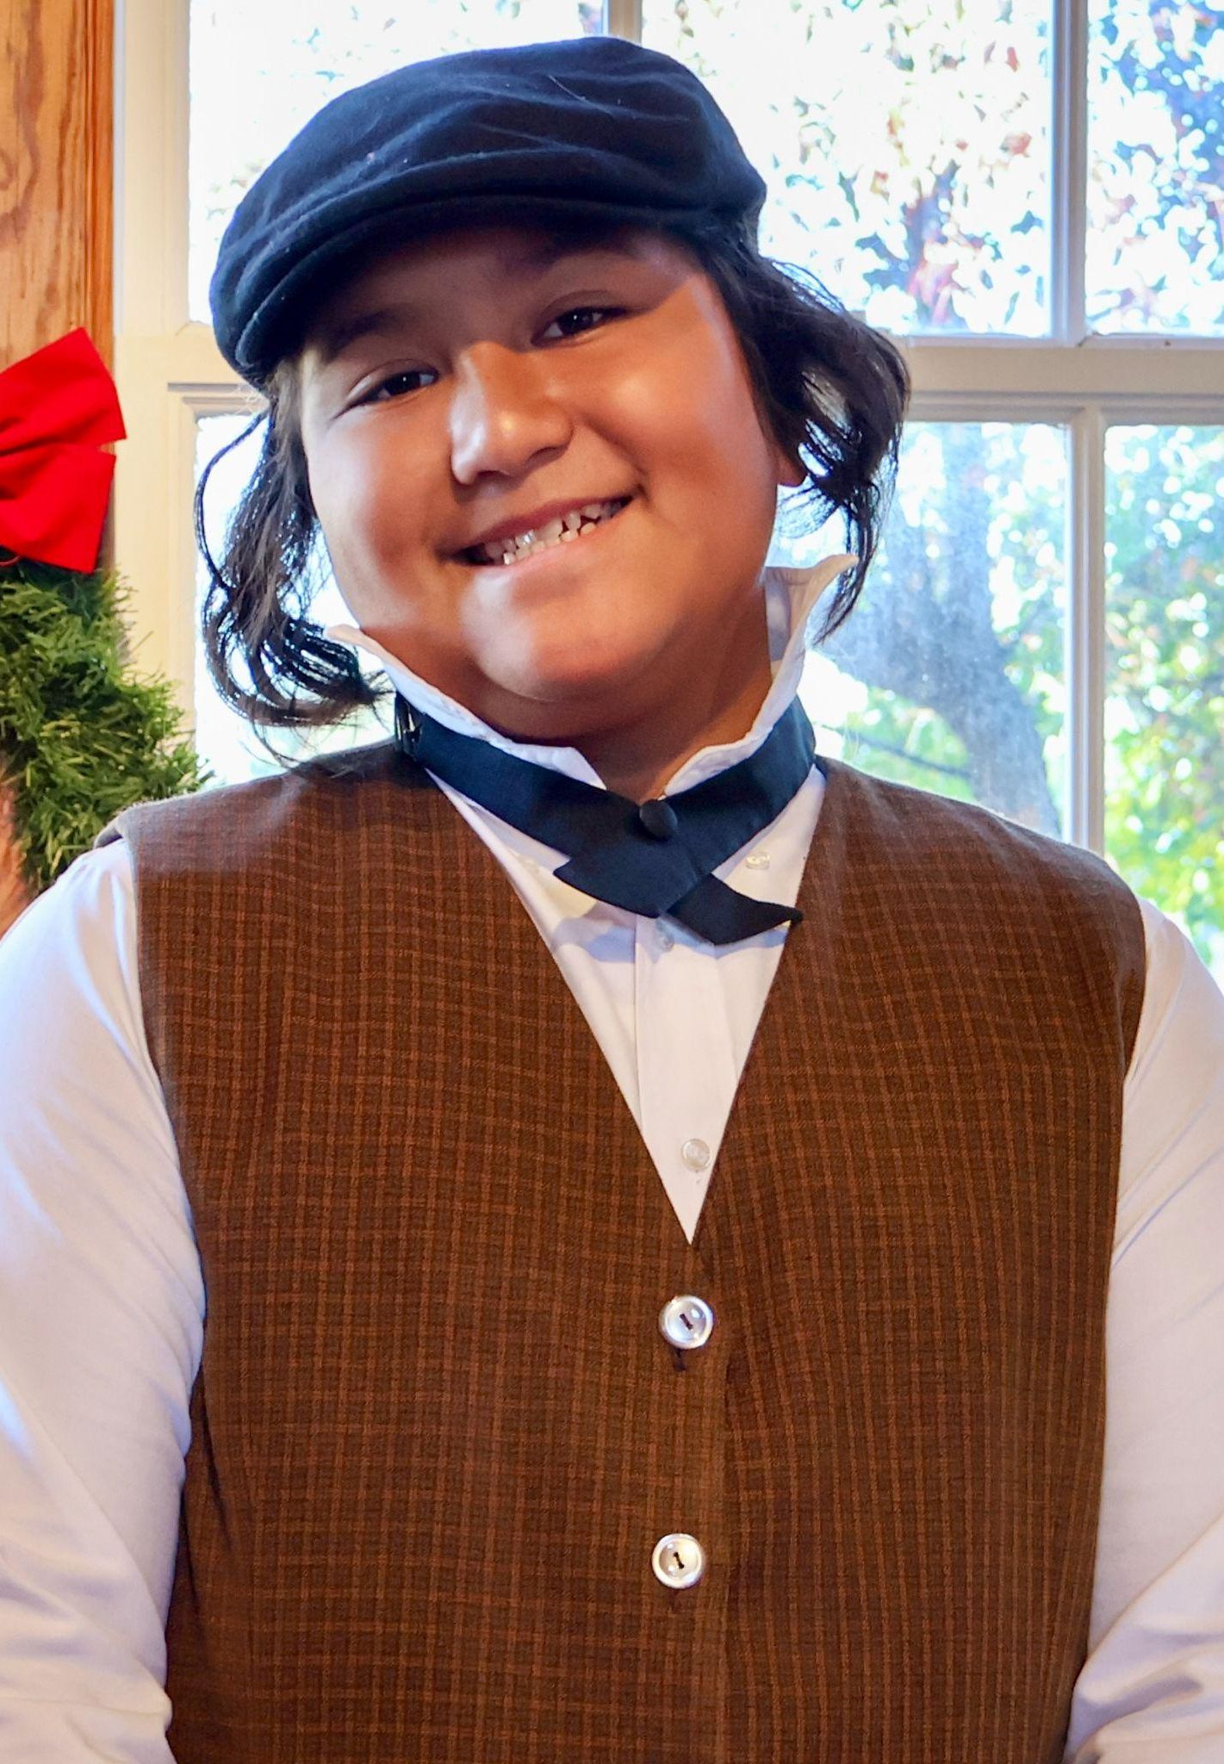
Keola Taylor
- Boy Scrooge & Ensemble
Keola has been part of Goose Creek Players since 2022, with his most notable role as Reynard the Dog in Cinderella this past spring.
In his free time, this homeschooler enjoys learning yoyo tricks, FNAF cosplay, collecting Garbage Pail kids, fixing old dolls, mixing music, and playing Gorilla Tag on his Oculus.

Slide 27
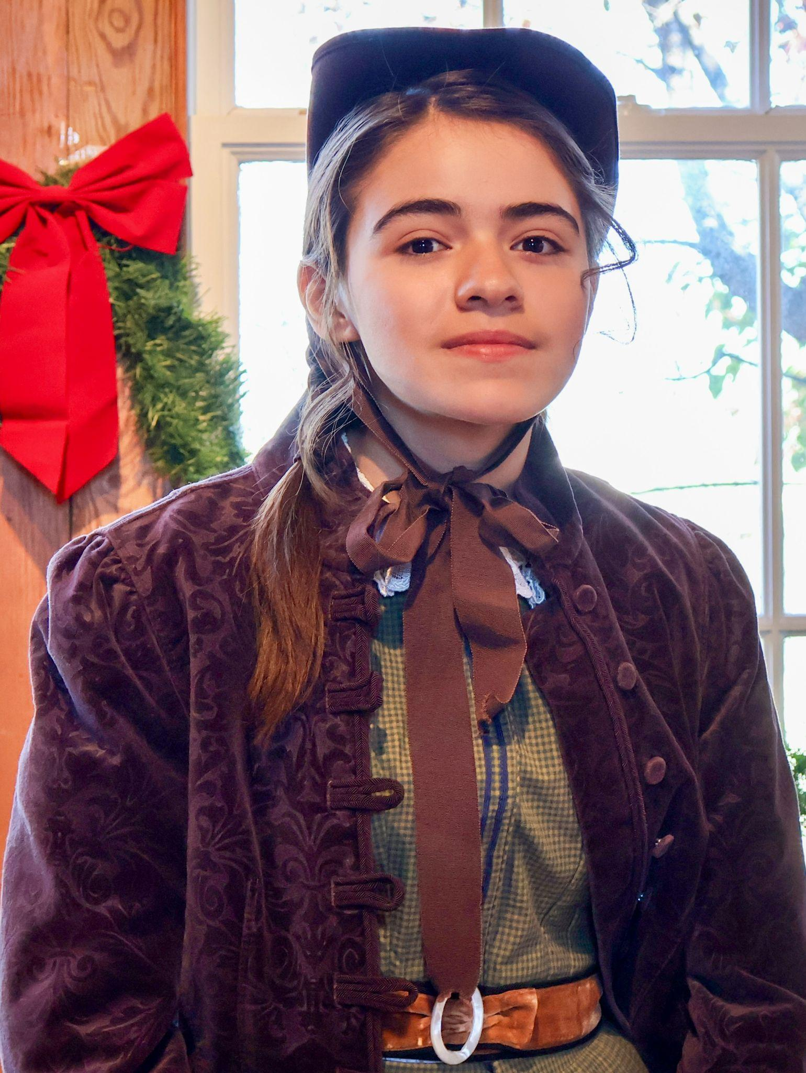
Wren Valdez-Bain
- Martha & Maid
Wren Valdez-Bain, a theatrical newcomer, is excited to make her stage debut as Martha and in the Ensemble.
She’s proud to be part of the cast and, when not on stage, enjoys reading, tree climbing, discussing dragons, and reciting digits of pi to anyone who will listen.

Slide 28
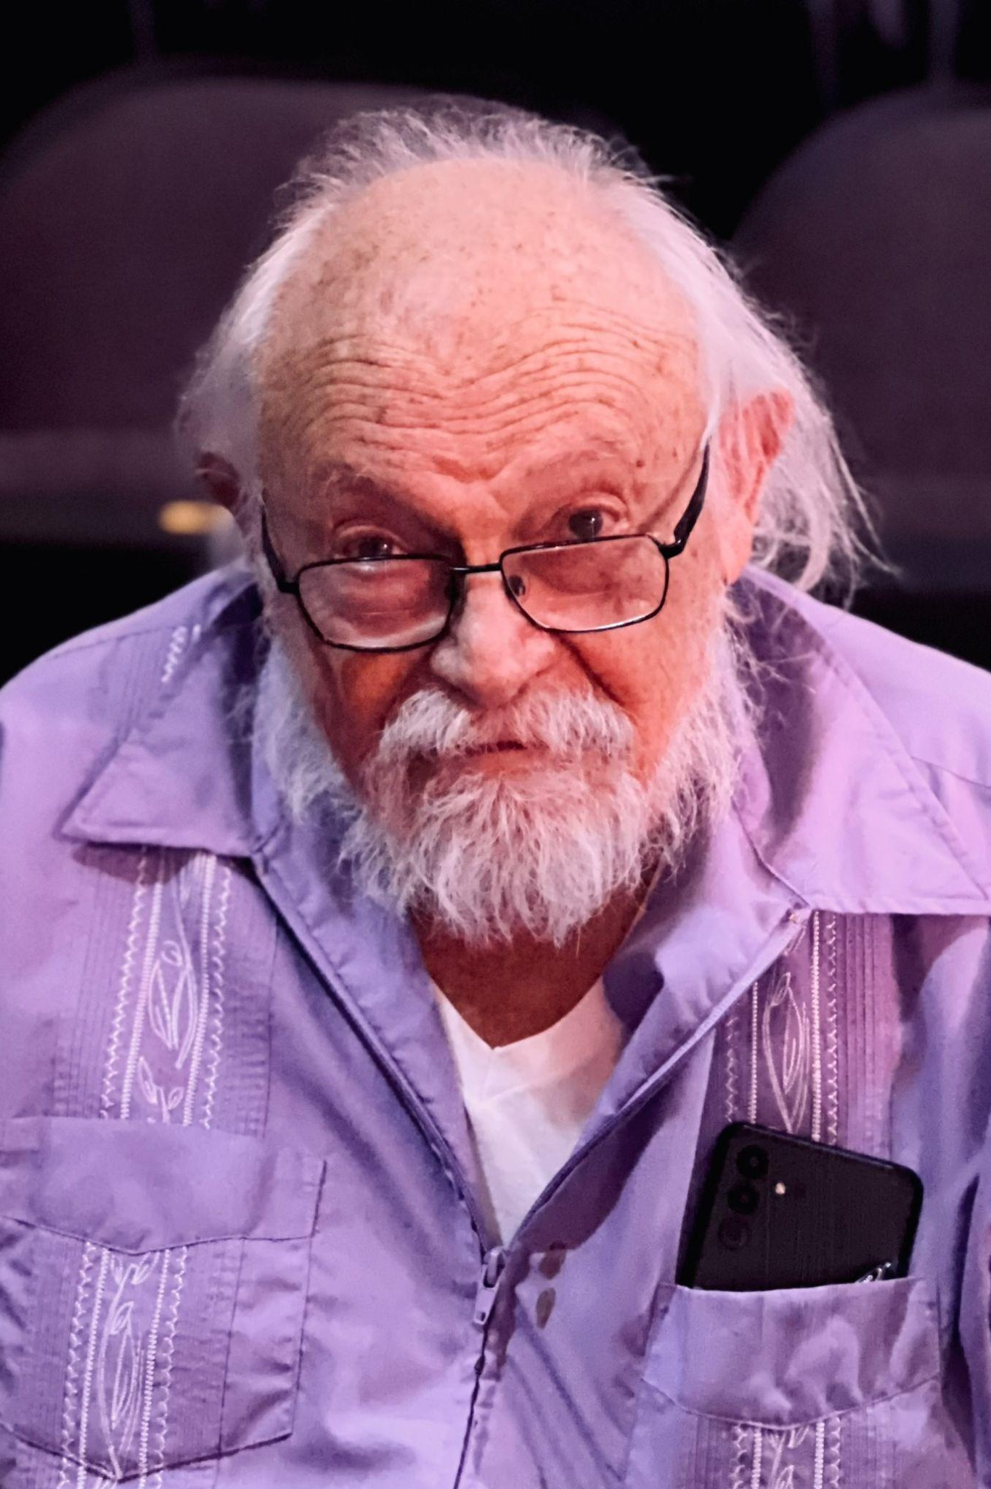
Jack Seeley
- Old Joe
Jack Seeley has a B.F.A. from Boston U. in Theatre Directing, and an M.A. from Baylor U. in Theatre History and Criticism. He has worked Off-Broadway, in L.O.R.T. theatres in Fort Worth and Baltimore, and with several local professional theatres, as well as a brief appearance in HBO’s The Wire. He has enjoyed the last 20+ years acting in local community theatres, specializing (his opinion) in Shakespeare’s clowns.

Slide 29
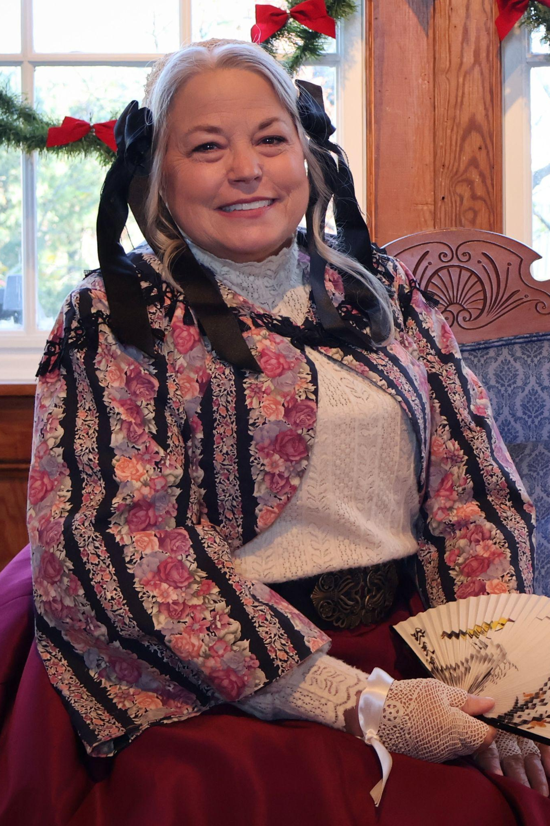
Cheri Shields
- Mrs. Applegate
Fresh from her role in The Crucible, Cheri Shields returns as Mrs. Applegate whose warmth contrasts Scrooge’s indifference and highlights his redemption.
Offstage, Cheri extends the same generosity and heartfelt spirit at Hidden View Bed & Breakfast, creating meaningful experiences that mirror Mrs. Applegate’s charitable values.

Slide 30
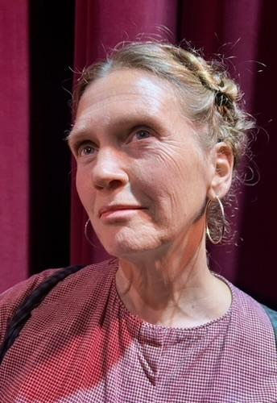
Karen McAnnany
- Narrator Two & Fred’s Wife
As one of your Narrators & Fred's Wife, I am excited to begin and end this awesome retelling of a holiday classic.
Although I am no stranger to theatre in the Northern Virginia area, this first production with Goose Creek has offered an amazing experience and the gift of new friends.

Slide 31
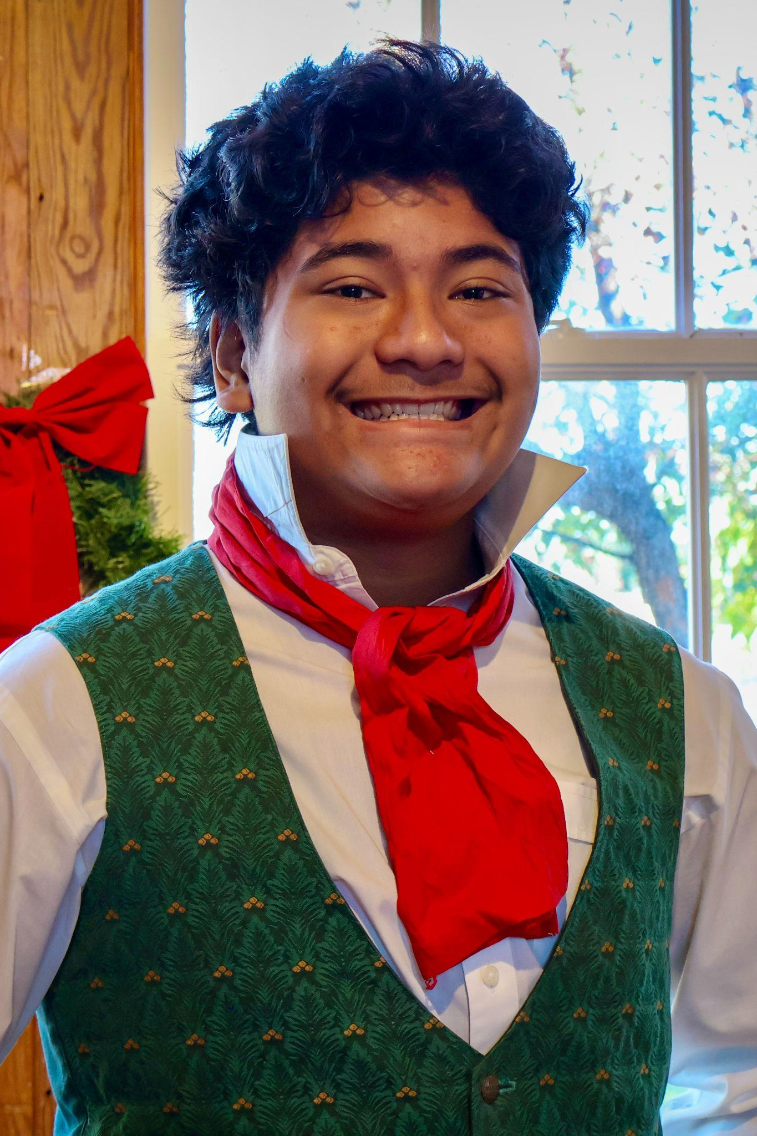
Kailani Taylor
- Mr. Harrington & Topper
Kailani Taylor caught the acting bug as Schwartz in Goose Creek Players' A Christmas Story in 2022. Since then, he has been involved in every GCP production, either on stage or behind the scenes.
Homeschooling allows him plenty of time to pursue other interests, including working out, playing Fortnite, and hanging with his dog.

Slide 32
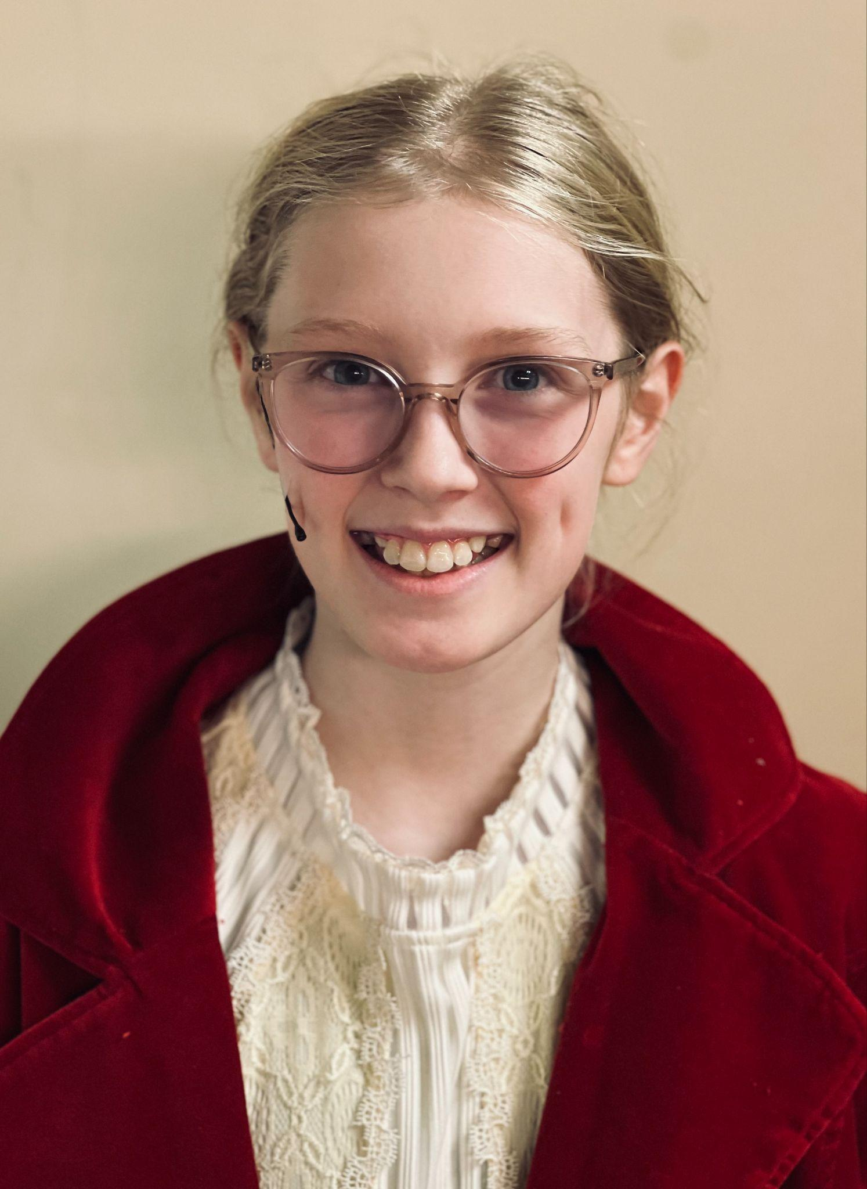
Rachel Russell
- Cratchit Kid & Ensemble
Rachel Russell is excited to be in her first production with Goose Creek Players.
She has enjoyed portraying Mrs. Gloop in Willy Wonka Jr, Peter Pan in Peter Pan Jr, and children’s ensemble roles for Scrooge! the Musical and Joseph and the Amazing Technicolor Dreamcoat.

Slide 33
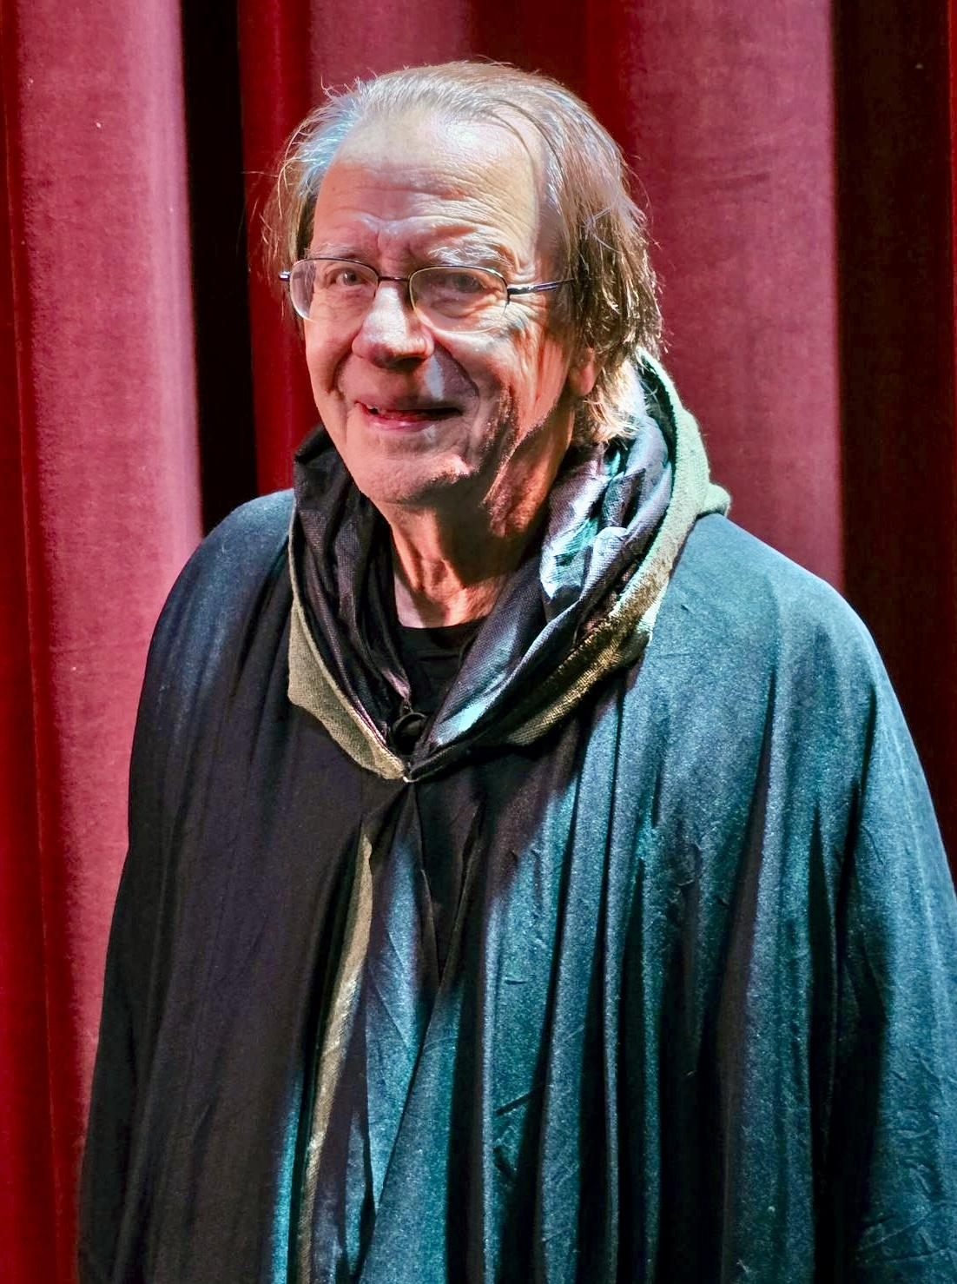
Tom Digre
- Ghost of Christmas Future
Tom Digre never wanted to perform in theatre but agreed to a non-speaking role (Ghost of Christmas Future, 2021) since he was accompanying his wife, Kathleen Donovan to rehearsals anyway.
He has also stood in for the invisible 6-foot rabbit in Harvey and most recently performed multiple roles in Eerie Evenings (Goose Creek Players).

Slide 34
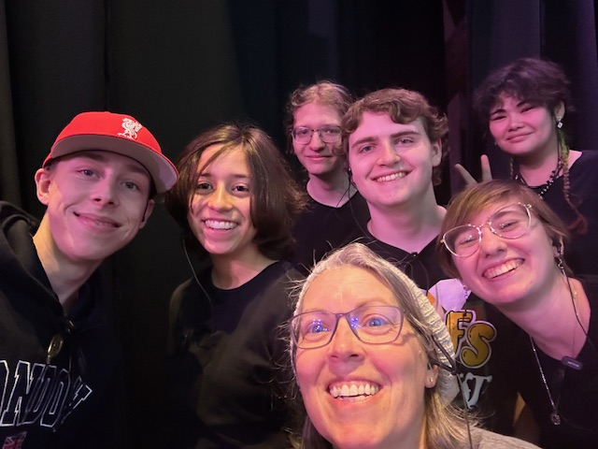
Stage Crew: Wishing you a Merry Christmas and a Happy New Year

Slide 35
Production Team
Producers…………Holly Gray & Melissa Barton
Director……………………..…..Mike Goshorn
Student Director………………...Julie Taylor
Stage Manager …..………………Jill Moore
Sound & Lights …………………Hana Taylor
Jill Moore
Props Manager………………….Anita Ault
Costume Designer……………..Elpitha Skuce
Seamstress …………………….Molly Hafner
Stacey Marsh
Accessory Design……………....Kim Valaer
Hair & Makeup Design…………..Nina Shields
Set Design & Construction …...Brian Williams Kelly Williams, Thomas Kane
Stage Crew ……………………..Sean Harris
Hamann Kohlweiler, Dylan Keefe,
Izzy Jewell, Alexa Fetterly, Dani Vitell,
Grace Vosburgh, Amelia Brandt
Teresa Valdez-Bain, Rachel Kavanagh
Makeup Assistant ……………...Mary Tanner,
Mia Holloway
Concessions & Public Relations…Melissa Barton
House Manager………………….Holly Gray

Slide 36
Special Thanks
Tree of Life Ministries
For your generous support and commitment to fostering community spirit.
Families of Our Cast and Crew
Your unwavering encouragement and support mean the world to us.
Our Valued Patrons
Thank you for continuing to support community theatre.

